Slide 1


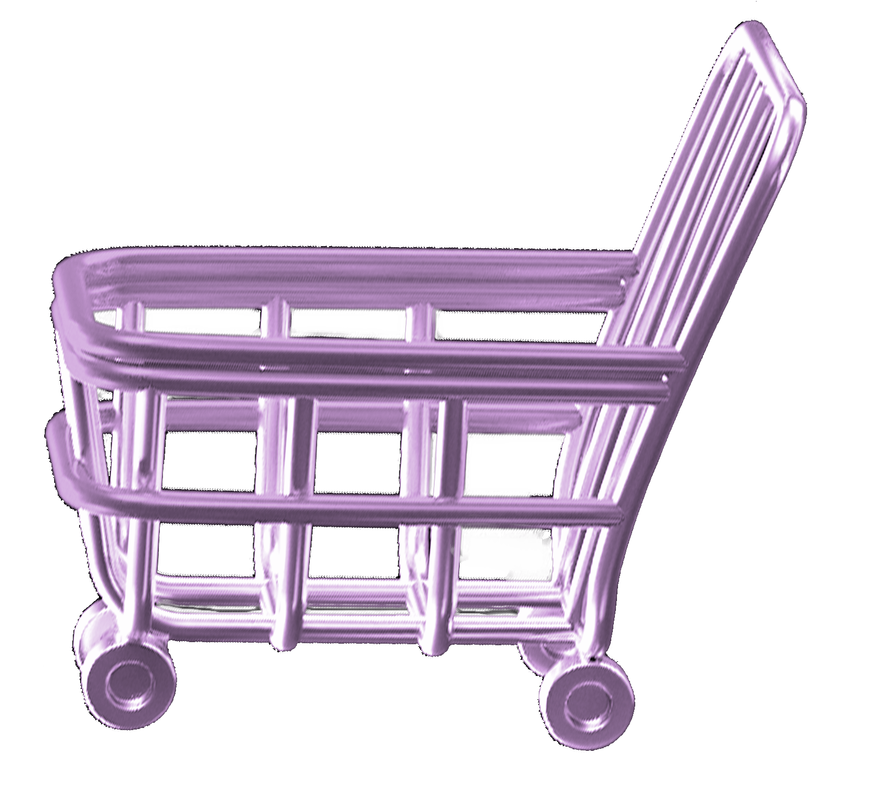
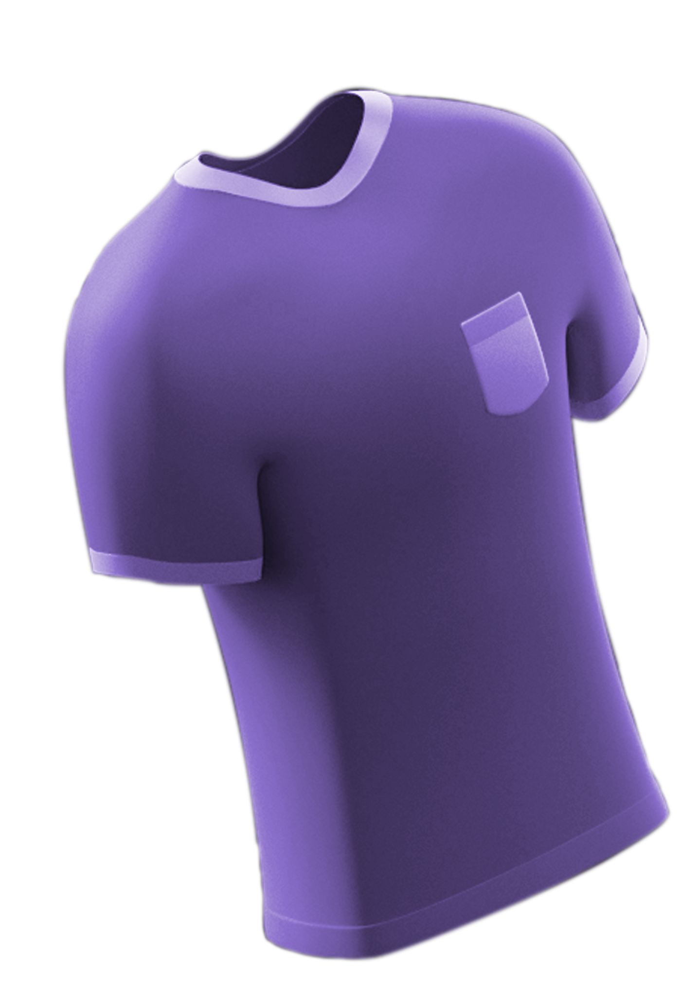
On Budget
APP

Slide 2
Project Members & Supervisors

Slide 3
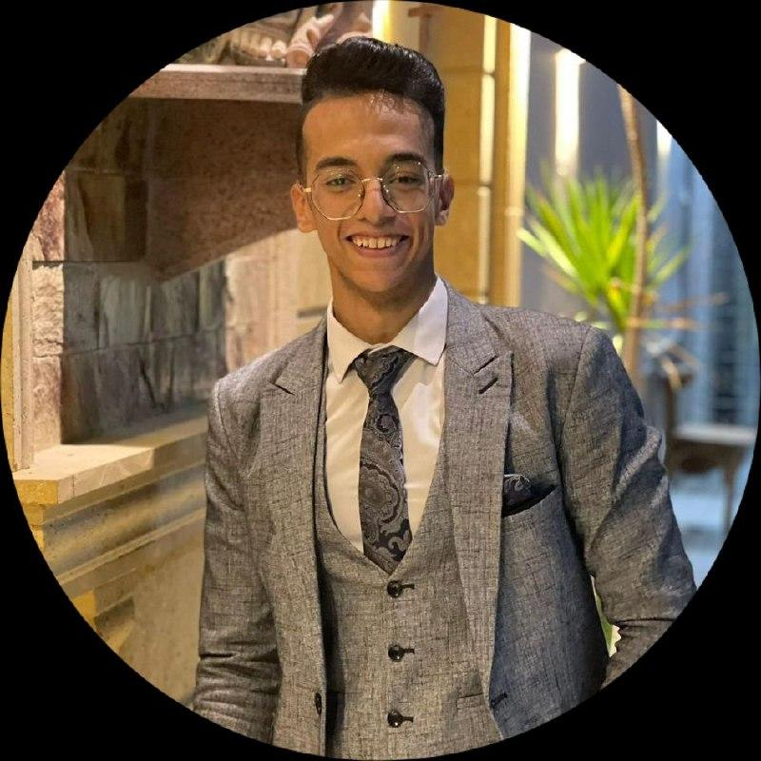





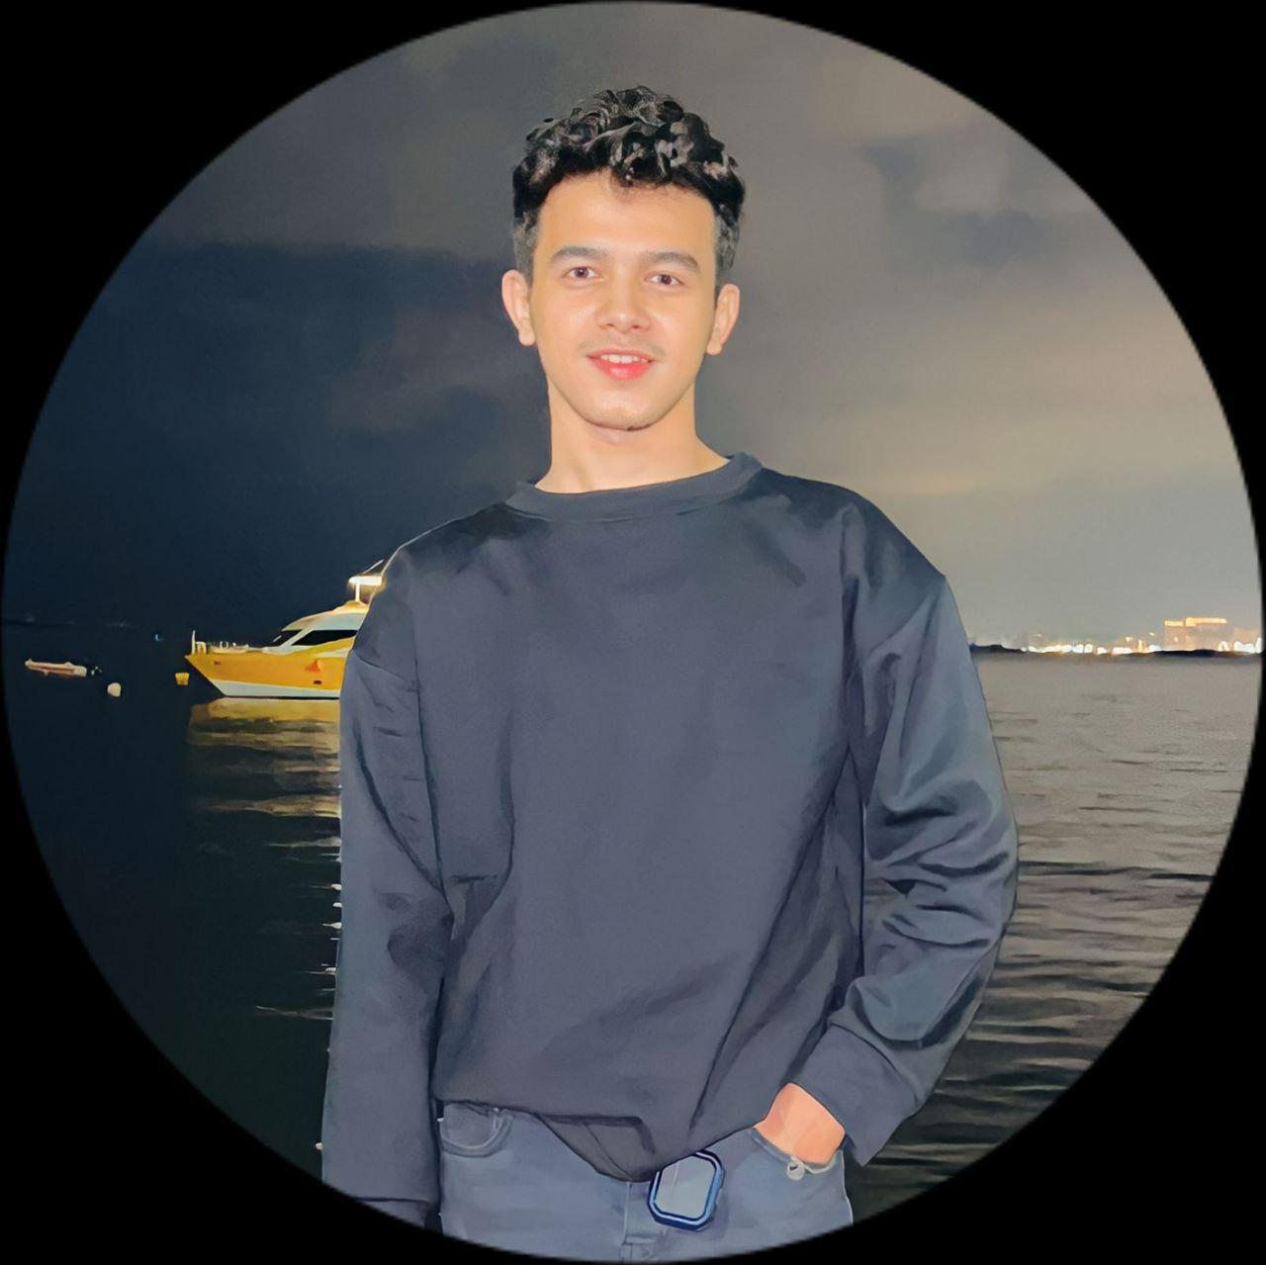
Project Members
Youssef Gerges
Ebram Shereen
Kerolos Karam
Mario Sarhan
Abdelrahman Ashraf
Osama Abdelghani
Omar Mohamed

Slide 4


Project Supervisors
Prof:
Dr. Kamal Hamza
Assistant Lecturer:
Eng. George Samy

Slide 5
Table of contents
01.
Introduction
02.
Related Work
03.
Numbers and Statistics
04.
Features
05.
Software requirements
06.
Mobile App
07.
FrontEnd
08.
BackEnd
09.
Gantt Chart

Slide 6
Introduction
01

Slide 7

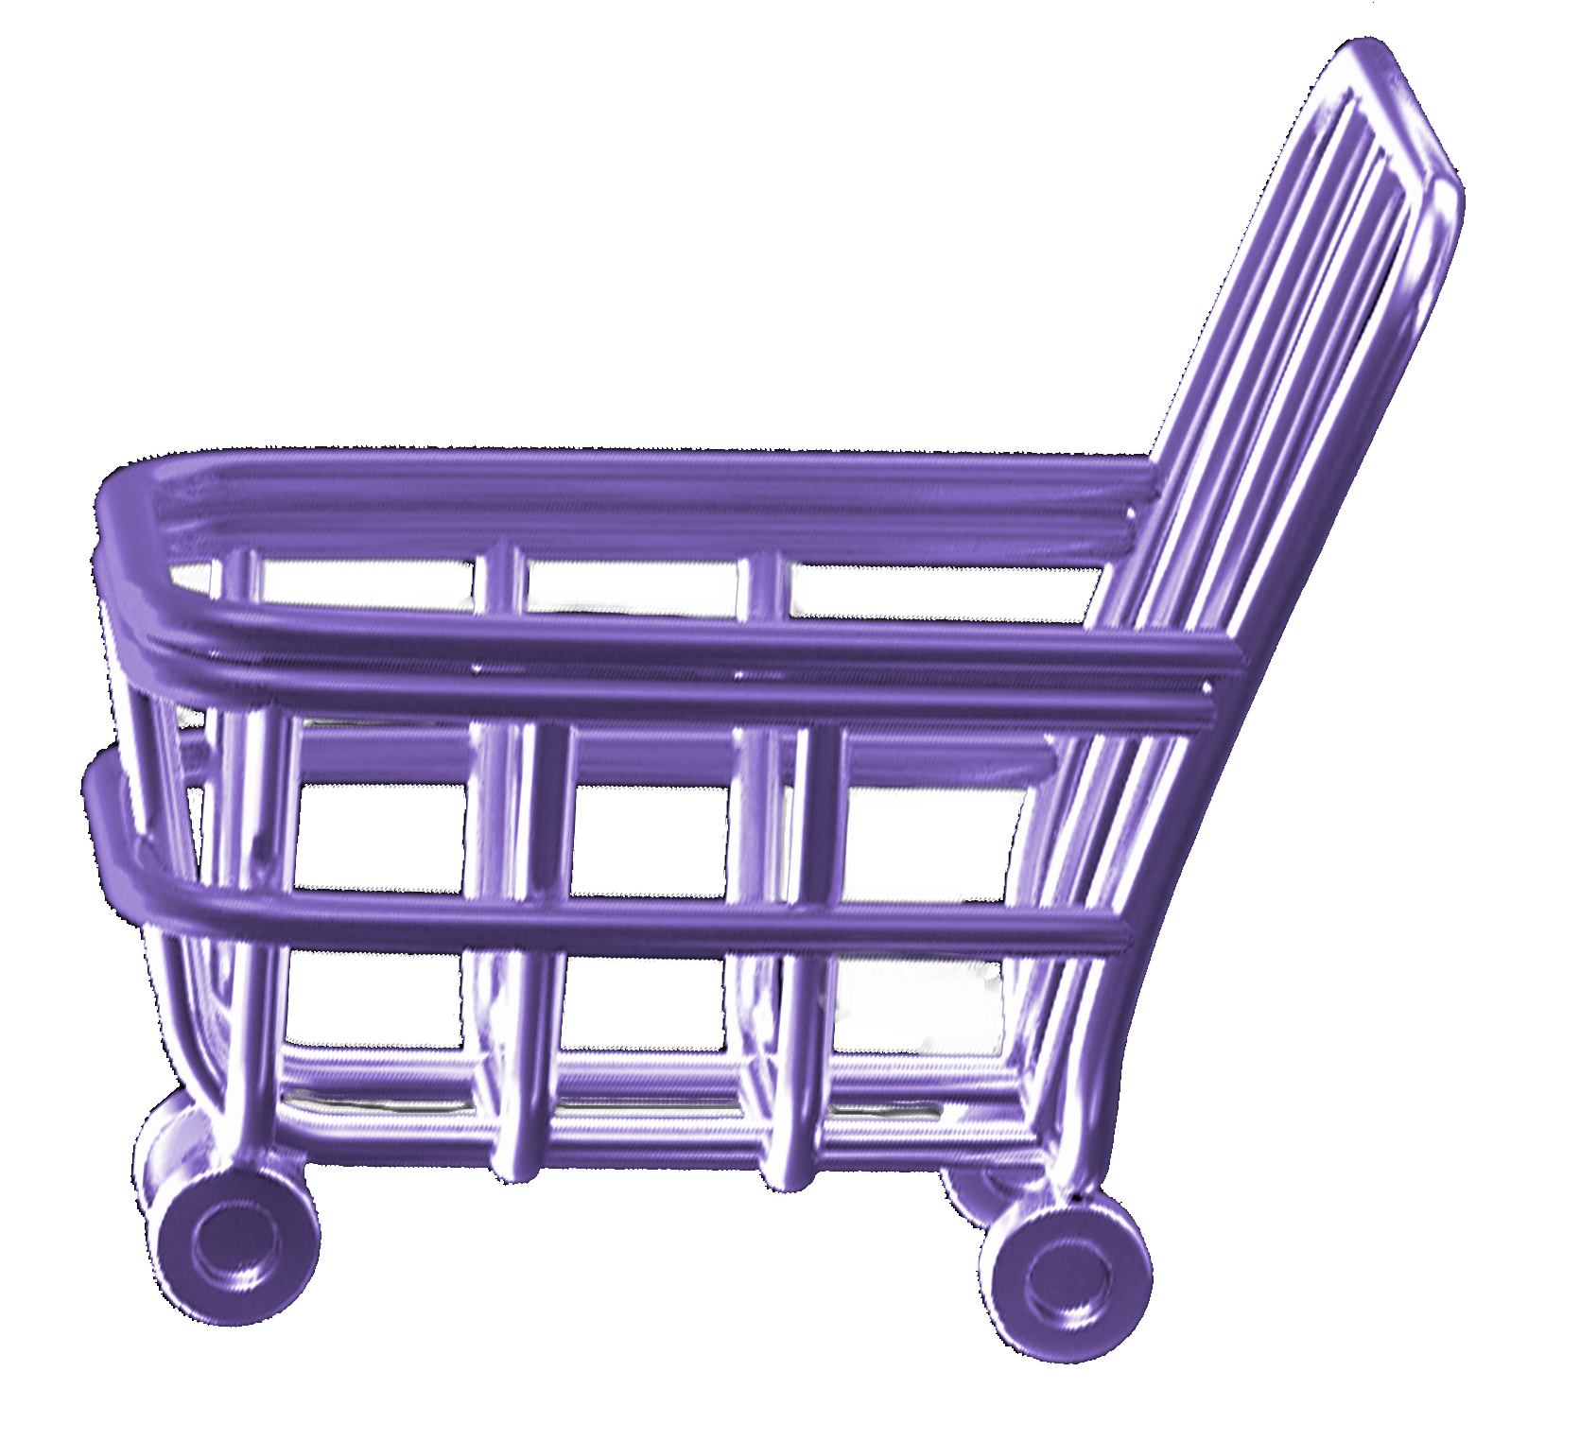
Introduction
"On Budget" app is designed to streamline clothing shopping across iOS, Android, and web platforms.
Features aid users in discovering, purchasing, and managing items within budget.
Seamless interaction between sellers and clients, merging physical and online shopping.

Slide 8
02
Related Work

Slide 9
Related Work
Mixed shopping platforms like Nike's, offering products both online and in physical stores, are not meeting expectations.
Our app unites local brands on one platform, eliminating the need for them to be present in both online and physical stores.

Slide 10
03
Numbers and Statistics

Slide 11
Numbers and Statistics
72% of Egyptian consumers have increased their online shopping activities since the COVID-19 pandemic began.
72%
Shoppers in Egypt prioritize speed and price when choosing businesses to buy from online, with 77% considering these factors as major considerations.
77%

Slide 12
Numbers and Statistics
Egypt E-commerce Market Analysis
The size of the Egypt e-commerce market is expected to grow from USD 7.88 billion in 2023 to USD 15.71 billion by 2028, at a compound annual growth rate (CAGR) of 14.80% during the forecast period (2023-2028).
Resource links: https://optinmonster.com/online-shopping-statistics/#Mobile

Slide 13
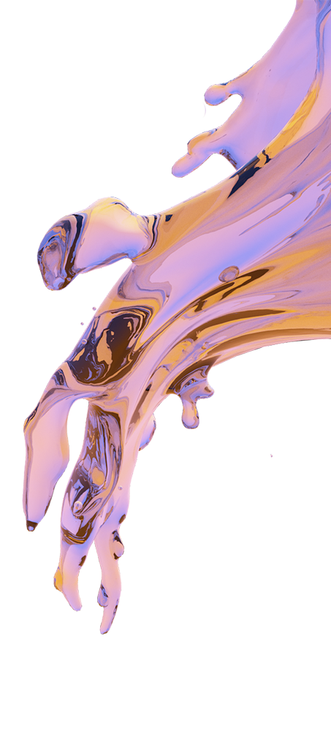
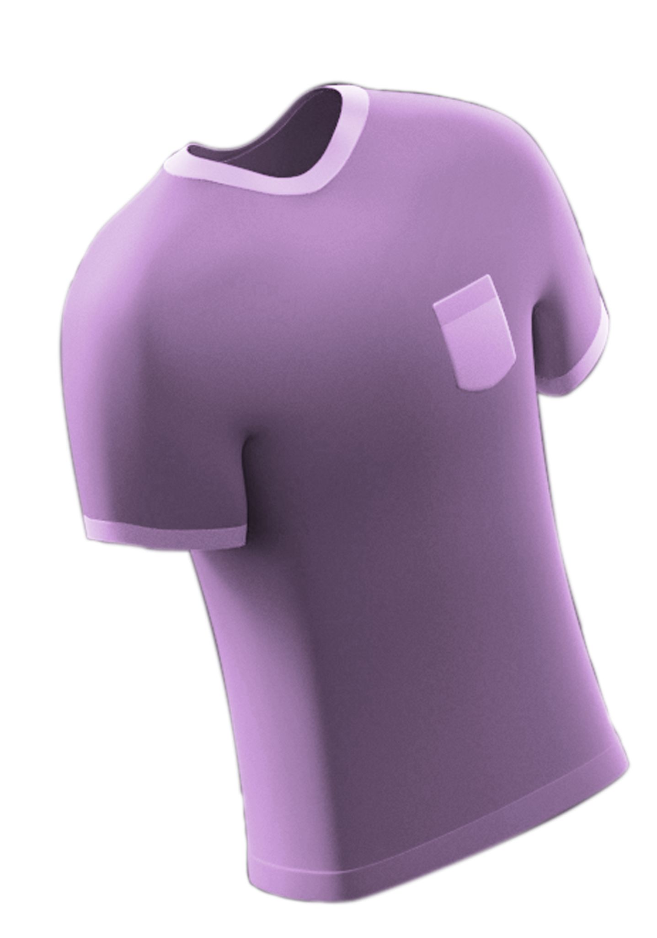
04
Features

Slide 14
Features
Online and Offline Stores Integration.
Budget-Based Recommendations.
Shipping Policy and Options.
Size generator
Custom your own T-shirt.
Product Recommendation.
Chatbot

Slide 15

Online and Offline Stores Integration
Integrating both online and physical stores can provide customers with a seamless shopping experience from home.
This feature can bridge the gap between online and offline shopping, offering customers the convenience of browsing items online.

Slide 16
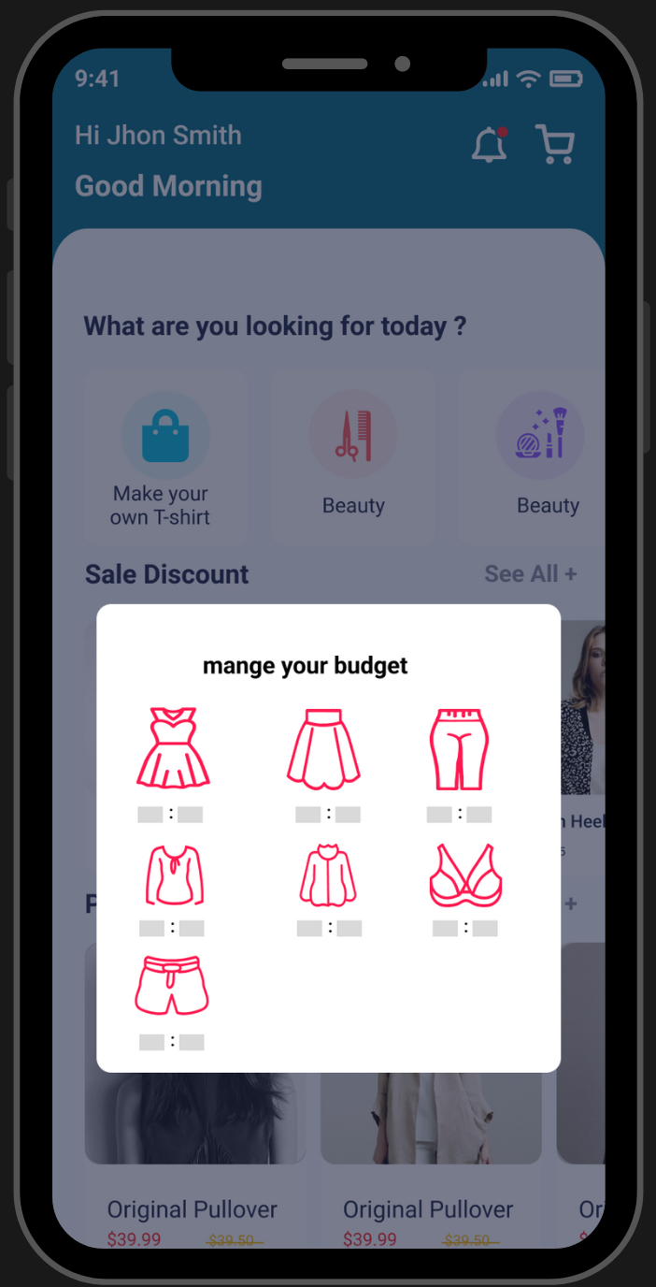
Budget-Based Recommendations
Allowing users to set a budget and receive tailored recommendations within that budget is a great way to enhance the shopping experience.

Slide 17
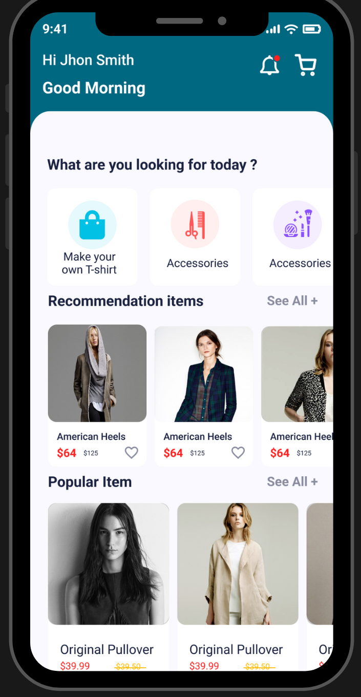
Product Recommendation.
Integrating seasonal and trending recommendations while meeting customer preferences enhances app relevance and encourages increased user engagement.
Average user savings per deal

Slide 18
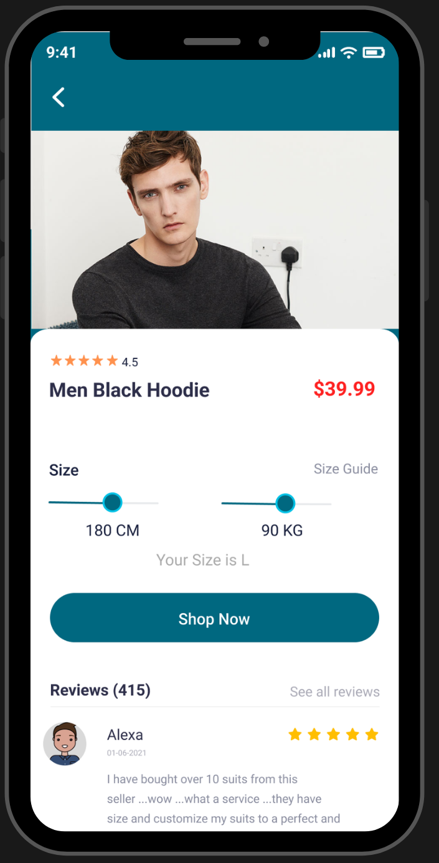
Size Predictor
Now, users can effortlessly find their fit by simply entering their height, weight, and age, via a Machine Learning model.

Slide 19

Machine Learning Model
Dataset
The only dataset that we found for our mission Kaggle dataset, which contains 120,000 samples across 4 columns:
1. Weight (in kgs)
2. Age
3. Height (in cm)
4. Size (XS , S , M , L , XL , XXL , XXXL ).
After removing duplicated values, the dataset was reduced to 33,754 samples. It's evident that a significant portion of the data was duplicated.
There were mostly no samples for the XXL category.
Consequently, predicting sizes based on the current state of the data posed a considerable challenge for us.

Slide 20
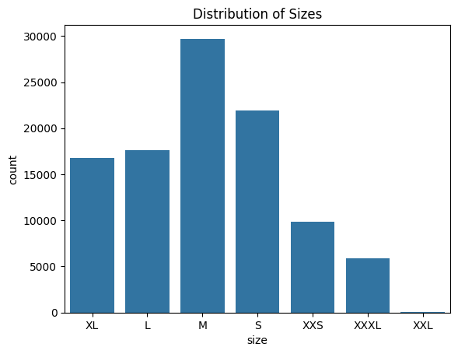
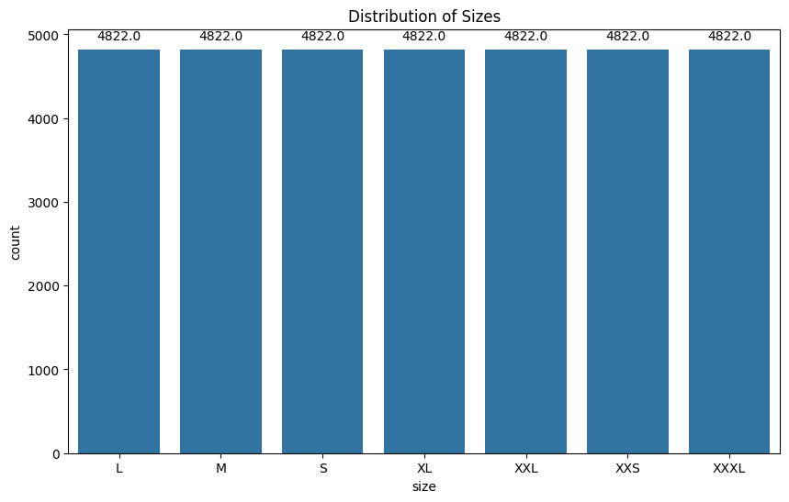
Dataset (Cont…)
The distribution of SIZE before & after applying SMOTE to treat the imbalance in the dataset

Slide 21
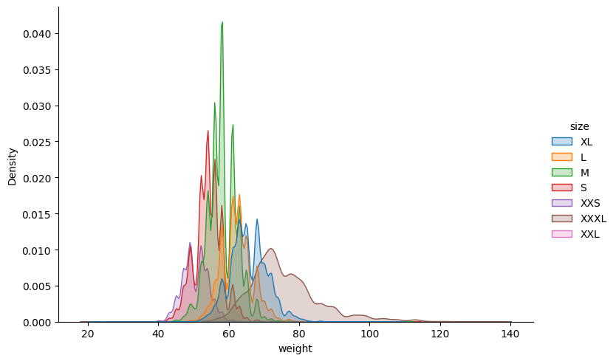
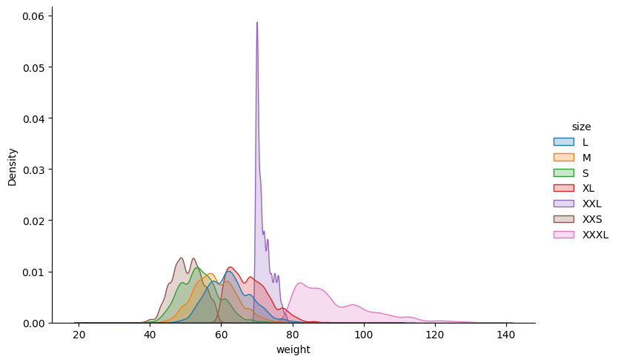
Dataset (Cont…)
The correlation between SIZE and WEIGHT density before & after data preprocessing
We also extracted the BMI based on weight and height making feature extraction to support the model during training

Slide 22
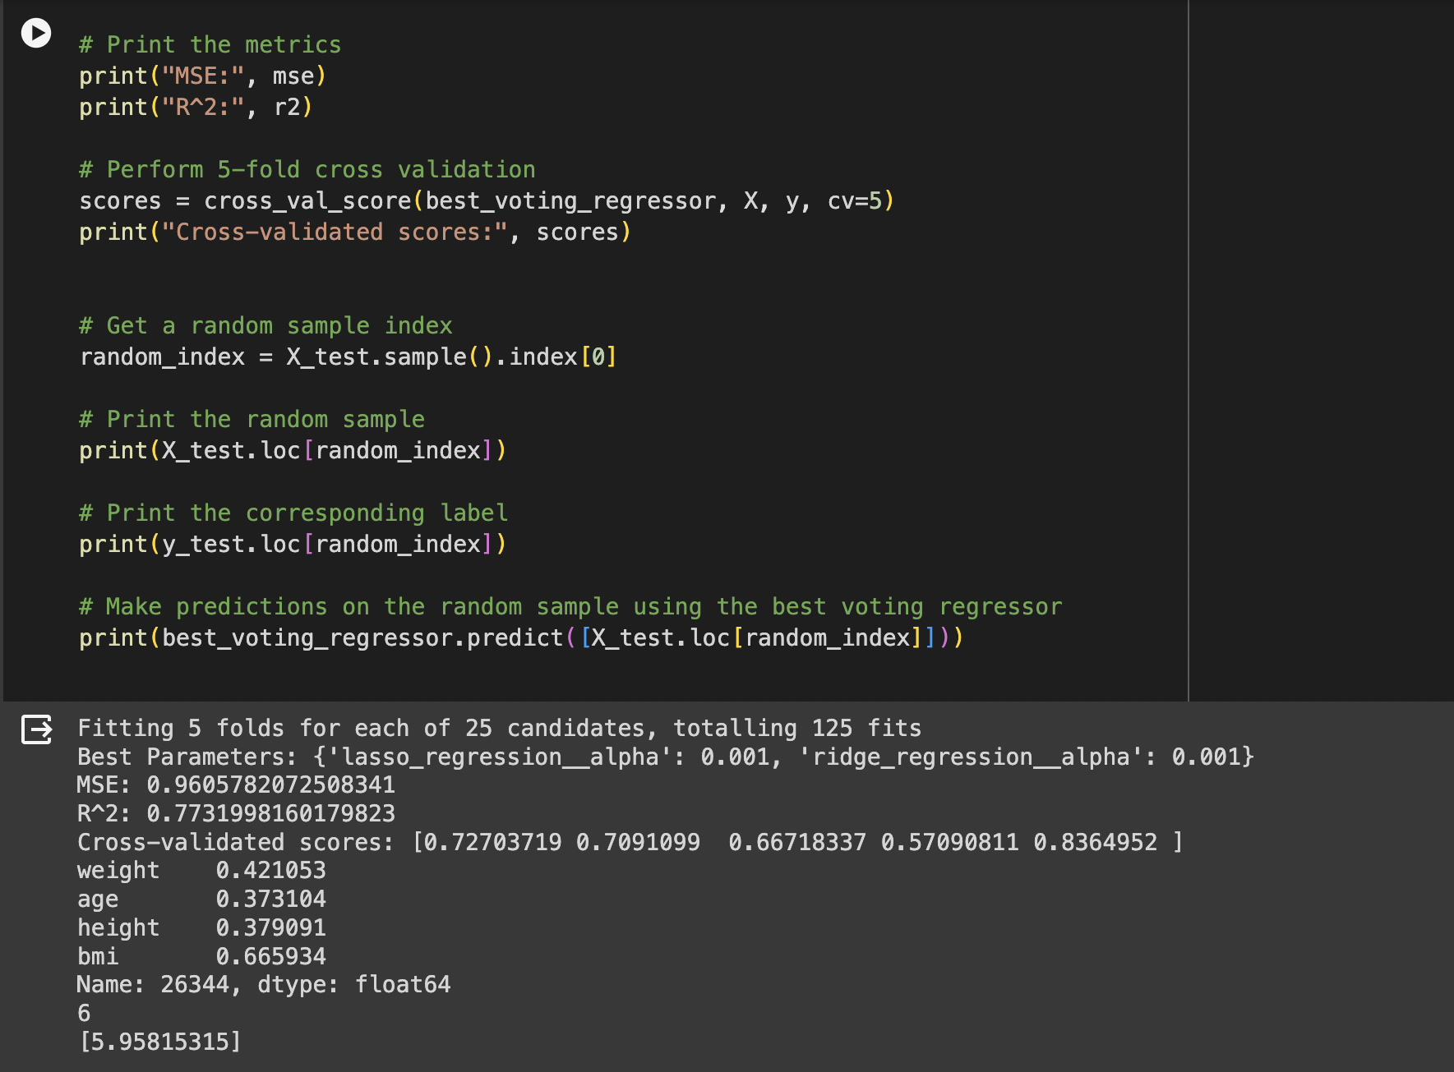
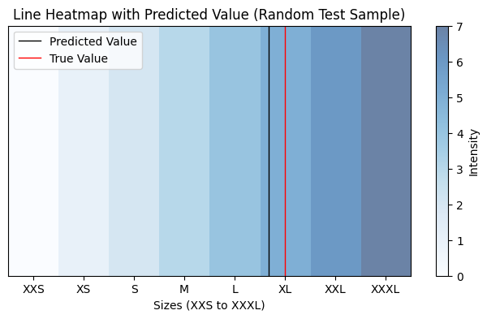
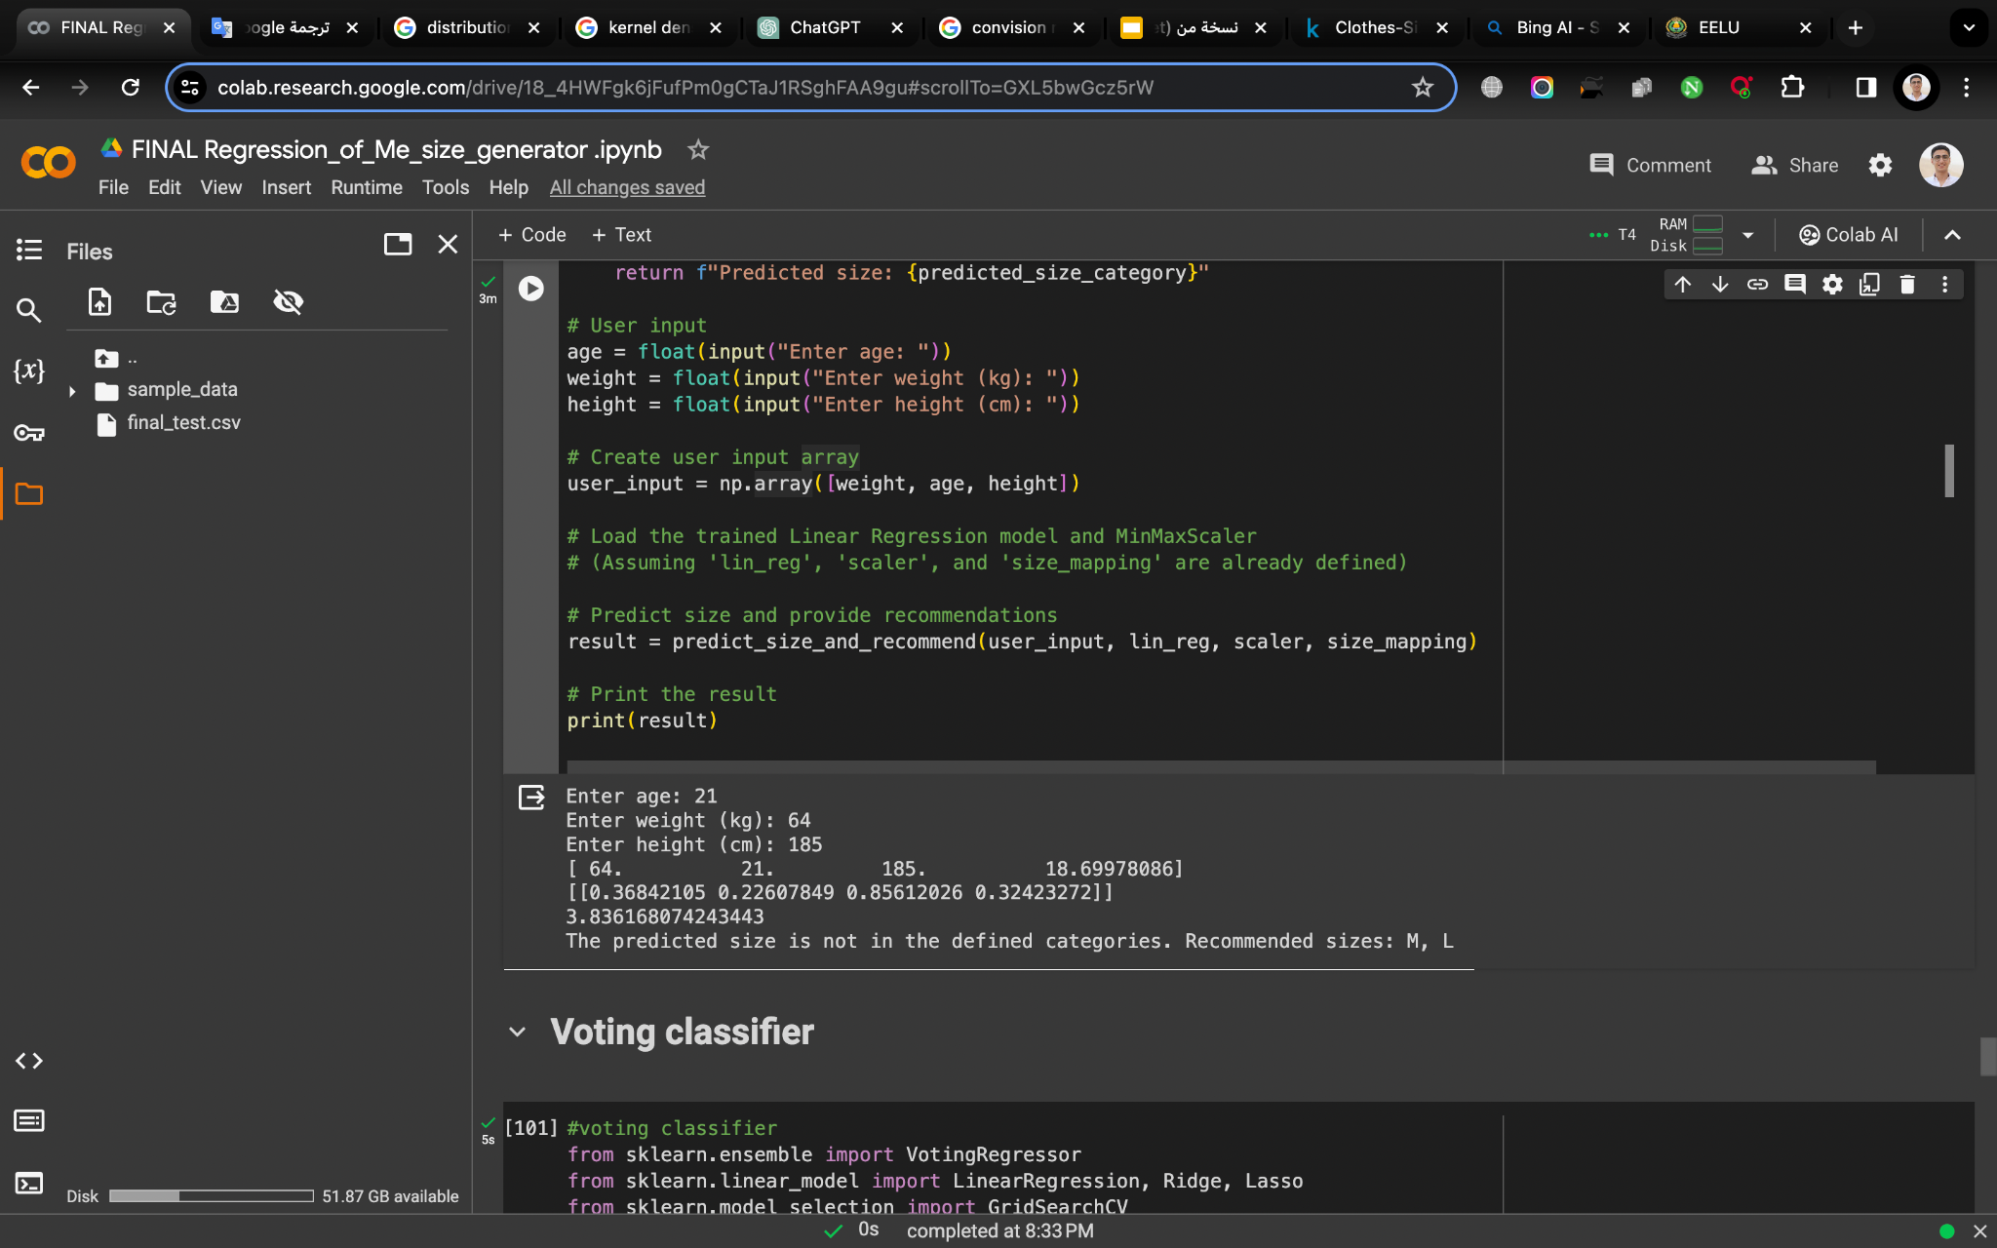
ML Model
We selected 2 Machine Learning models for our mission:
Linear Regression: This model yielded a very good score.
Voting Classifier with Ridge, Lasso, and Linear Regression: This model produced results that were largely similar to those of the Linear Regression model.
The metrics for this model were as follows:
Mean Squared Error (MSE): 0.96
R^2: 0.77
we also conducted tests on the model after deployment using external samples.
This was done to ensure that the model is capable of predicting the size of samples that are external to the dataset.
note that these results were not achieved without the hard work put into Exploratory Data Analysis (EDA) and data preprocessing.

Slide 23
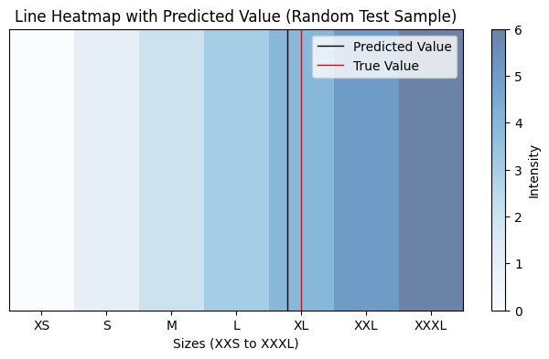
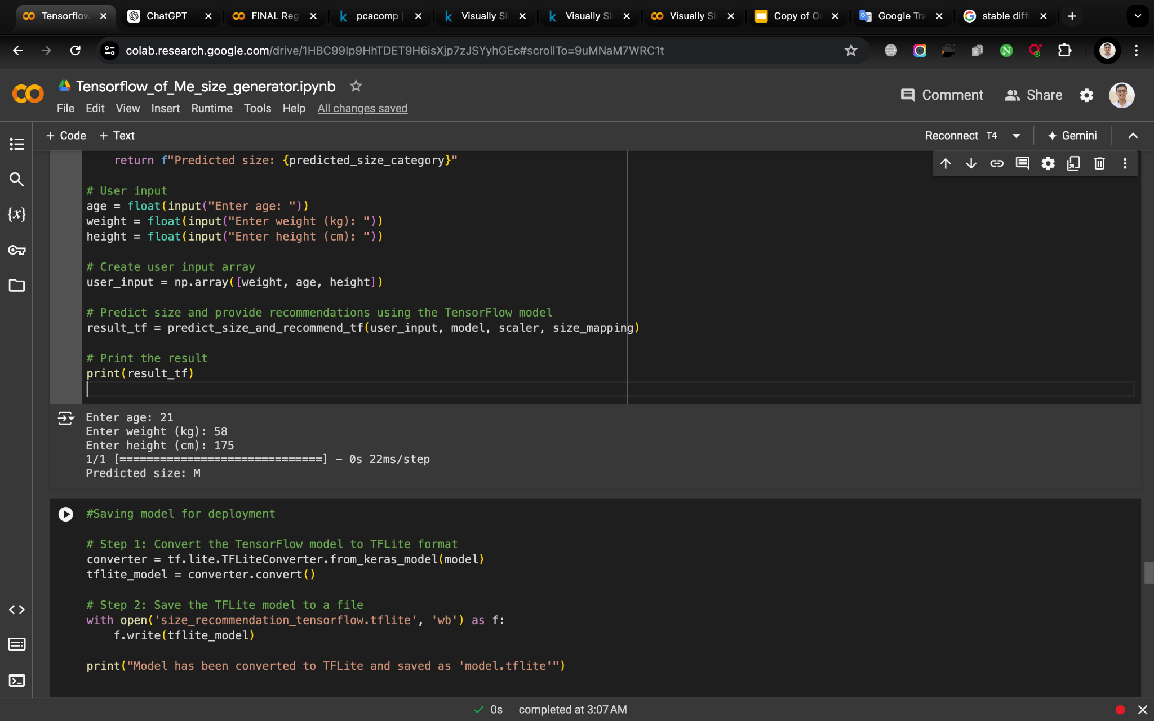
Size Predictor (updated…)
• We have updated our model by collecting more data via surveys and turned it into a deep learning model using TensorFlow.
• The model obtained accurate size predictions, and we also tested it with external data to ensure model capability to predict sizes outside the test data.

Slide 24
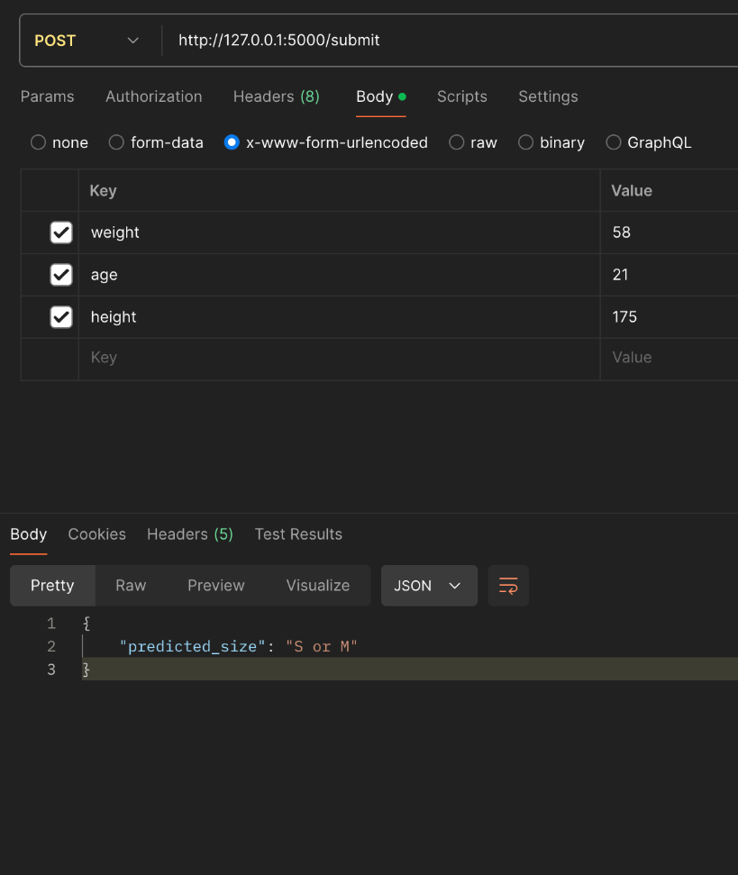
Flask deployment
•User Input and Data Processing
• Users submit weight, age, and height through a POST request to the `/submit` endpoint.
•Model Loading and Prediction
• The application loads a pre-trained Tensorflow model and a scaler to normalize the input data.
• It predicts the appropriate clothing size by calculating BMI and mapping the prediction to a size category.
•Results
• The predicted size is returned as a JSON response.
•This allows easy consumption by both mobile and web applications for smooth user interaction.

Slide 25
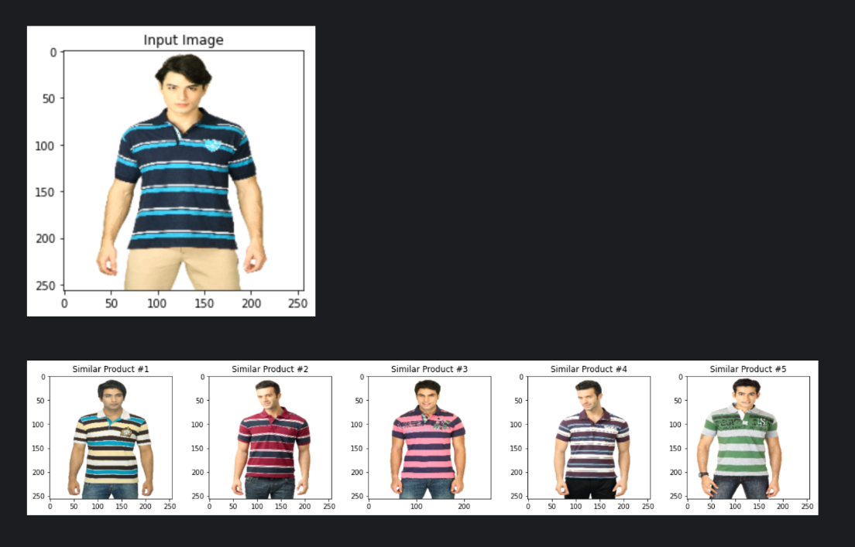
Recommendation with Visual Similarity:
Introduction
• Recommendation model to help users find relevant items.
• We'll discuss recommendation, VGG16 feature extraction, and KNN for visual similarity.
1. Recommendation:
• Recommender model suggest items based on user preferences.
• Content-based filtering recommends items similar to user preferences.

Slide 26
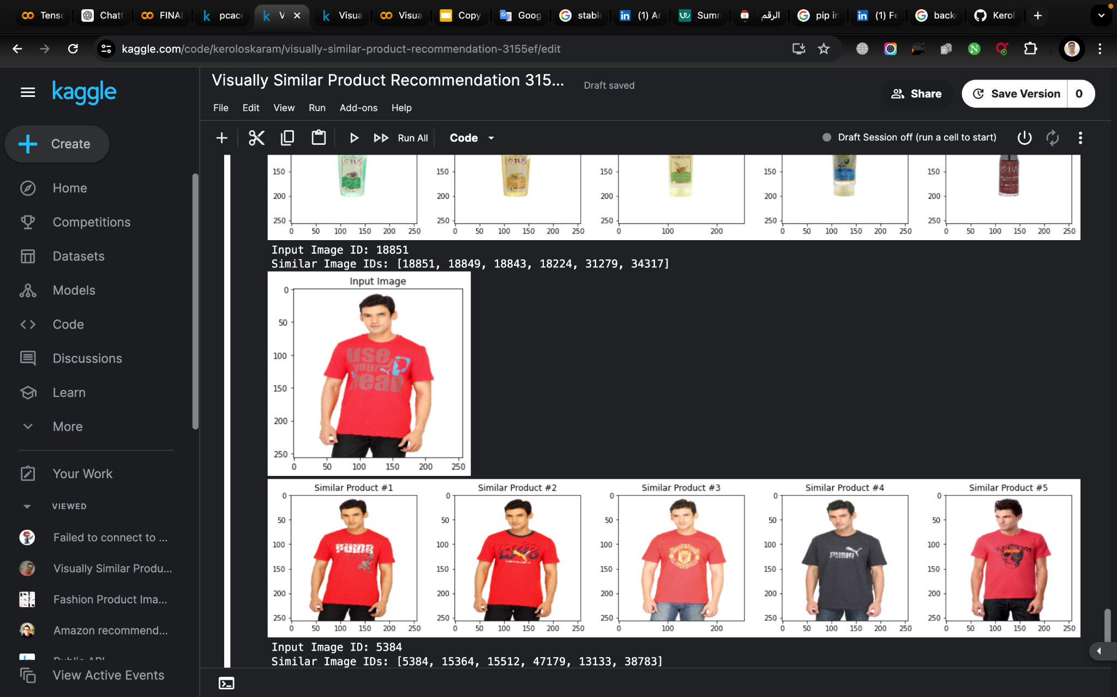
Recommendation with Visual Similarity (cont…)
2. Feature Extraction:
• Extracts essential information from data.
• Pre-trained models like VGG16 extract features from images.
3. K-Nearest Neighbors (KNN):
• KNN finds the K-nearest neighbors to a given item.
• It identifies visually similar products based on feature vectors.
Conclusion:
• Combining recommendation, feature extraction,and KNN creates robust visual similarity recommendations.

Slide 27
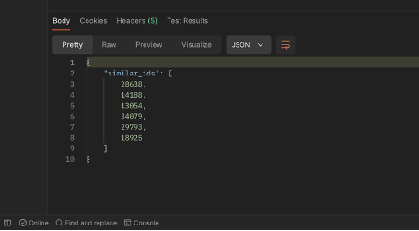
Flask deployment
• We have created a Flask endpoint for deploying our Fashion Recommendation model to host it for a mobile app and web.
• Extracts features from a given image URL and finds similar fashion items; the pre-loaded model returns similar product IDs.
• Processes POST requests to provide fashion recommendations with robust input validation and error handling.
• Utilizes pre-loaded model for accurate image processing and recommendations.

Slide 28
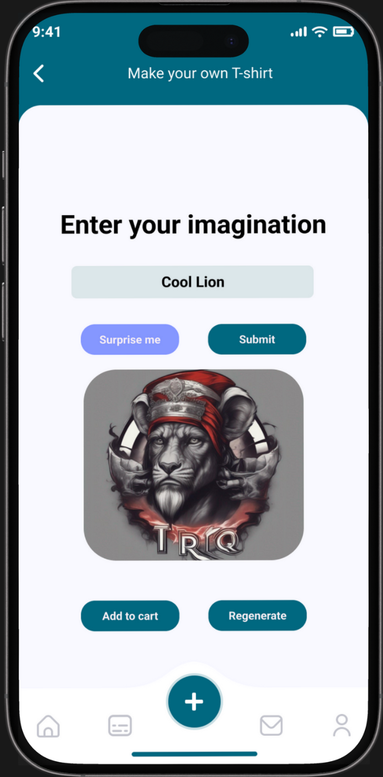
Custom your own T-shirt.
Transforming user input into Unique T-Shirt Designs!
Our feature allows customers to transform their text into unique t-shirt designs.
Stable Diffusion is a type of generative AI model, specifically a text-to-image diffusion model. It’s capable of generating high-quality, photo-realistic images from text descriptions. This model is considered a significant advancement in the field of generative AI due to its ability to produce images with a high degree of control over the output.

Slide 29
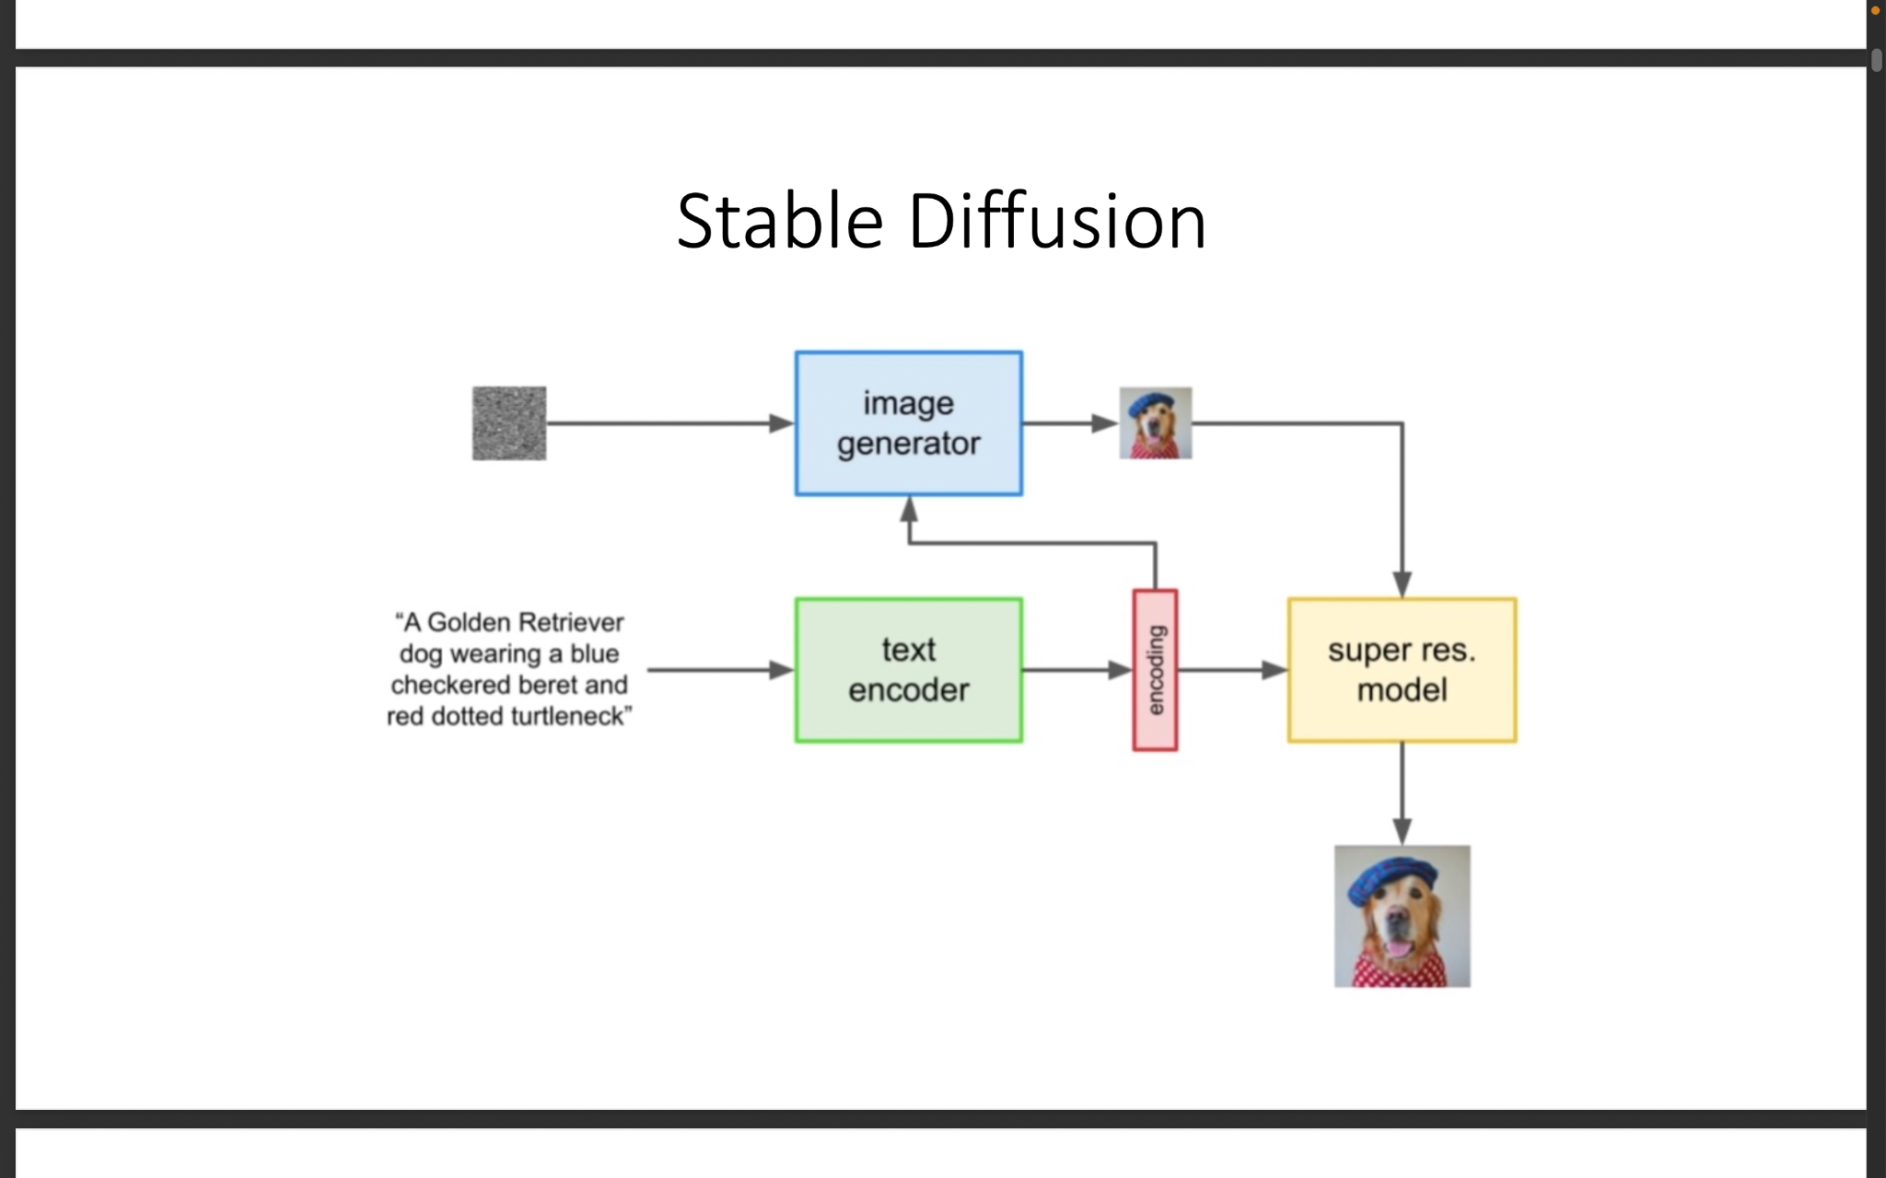
Stable Diffusion (Cont…)
The image represents a Stable Diffusion deep learning model.
The process starts with a text description, which is converted by a “text encoder” into a format suitable for the “image generator”.
This generator creates a low-resolution image based on the encoded text.
Finally, a “super resolution model” enhances this image, resulting in a high-resolution output that accurately depicts the initial text description.

Slide 30
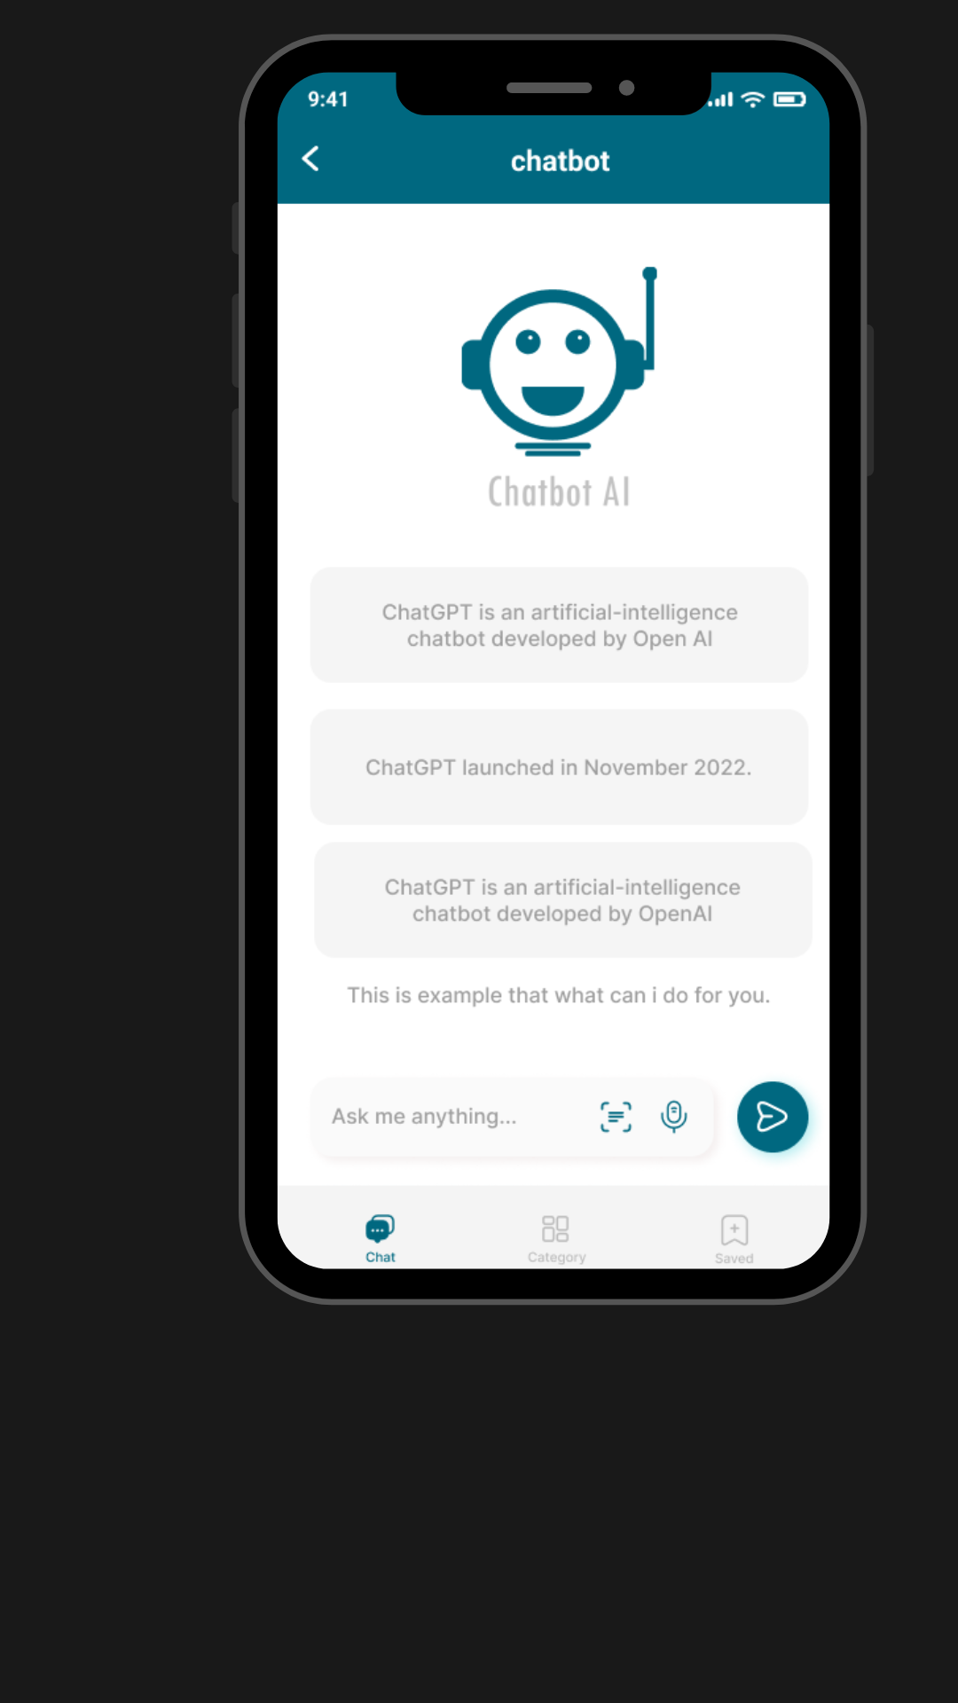
Chatbot
A chatbot can provide real-time customer support, answer user queries, help with recommendations, and assist with common issues. Chatbots enhance user engagement and customer satisfaction by providing immediate assistance.

Slide 31
06
Mobile App

Slide 32


Framework
Our e-commerce graduation project, powered by the Flutter framework, offers a unified experience across Android and iOS. With Flutter's rapid development capabilities and performance advantages, we've created a visually appealing and efficient platform for seamless online shopping.

Slide 33
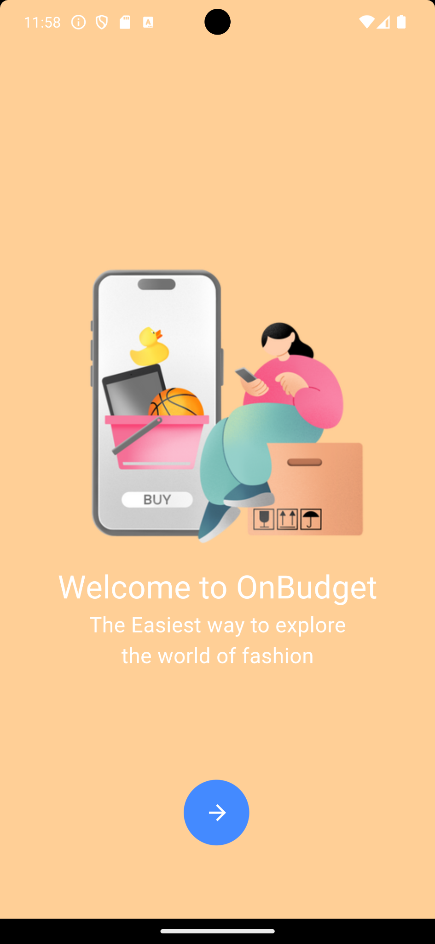
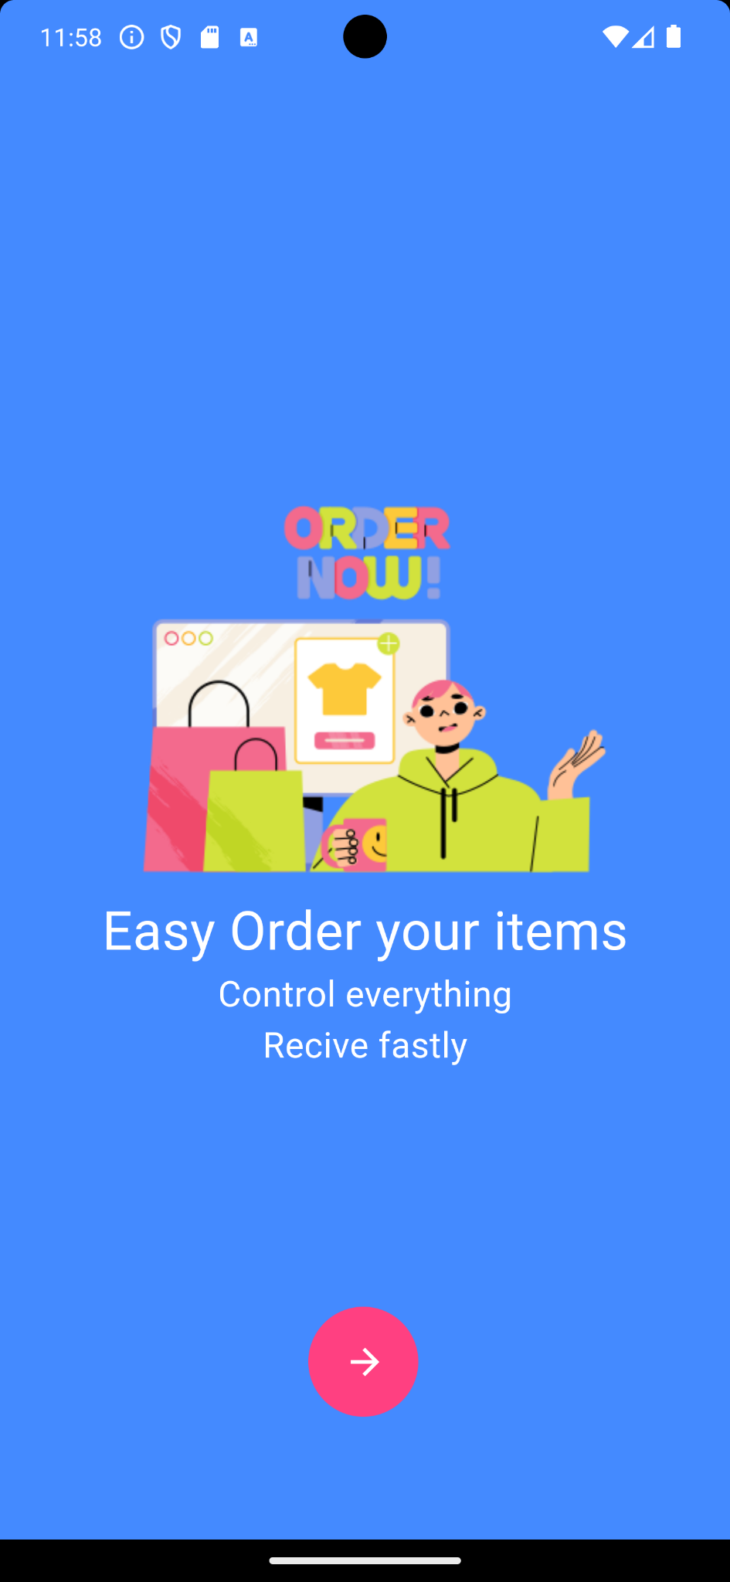
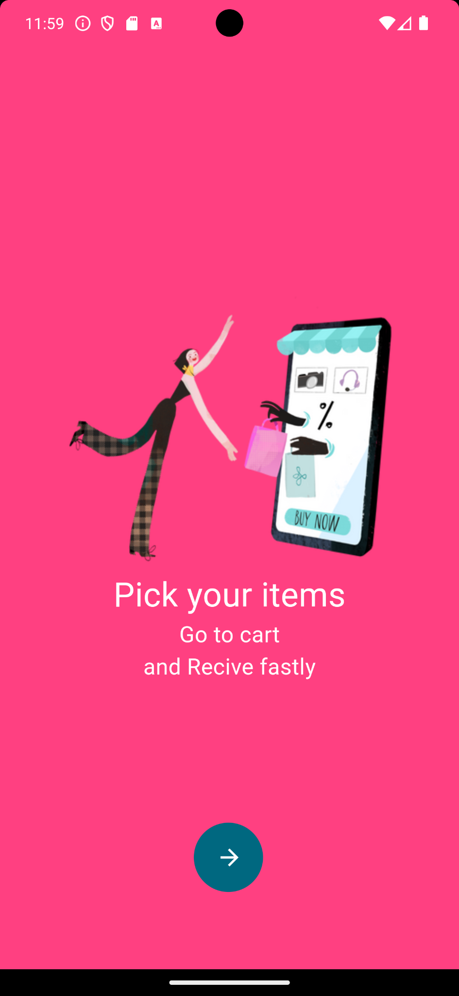
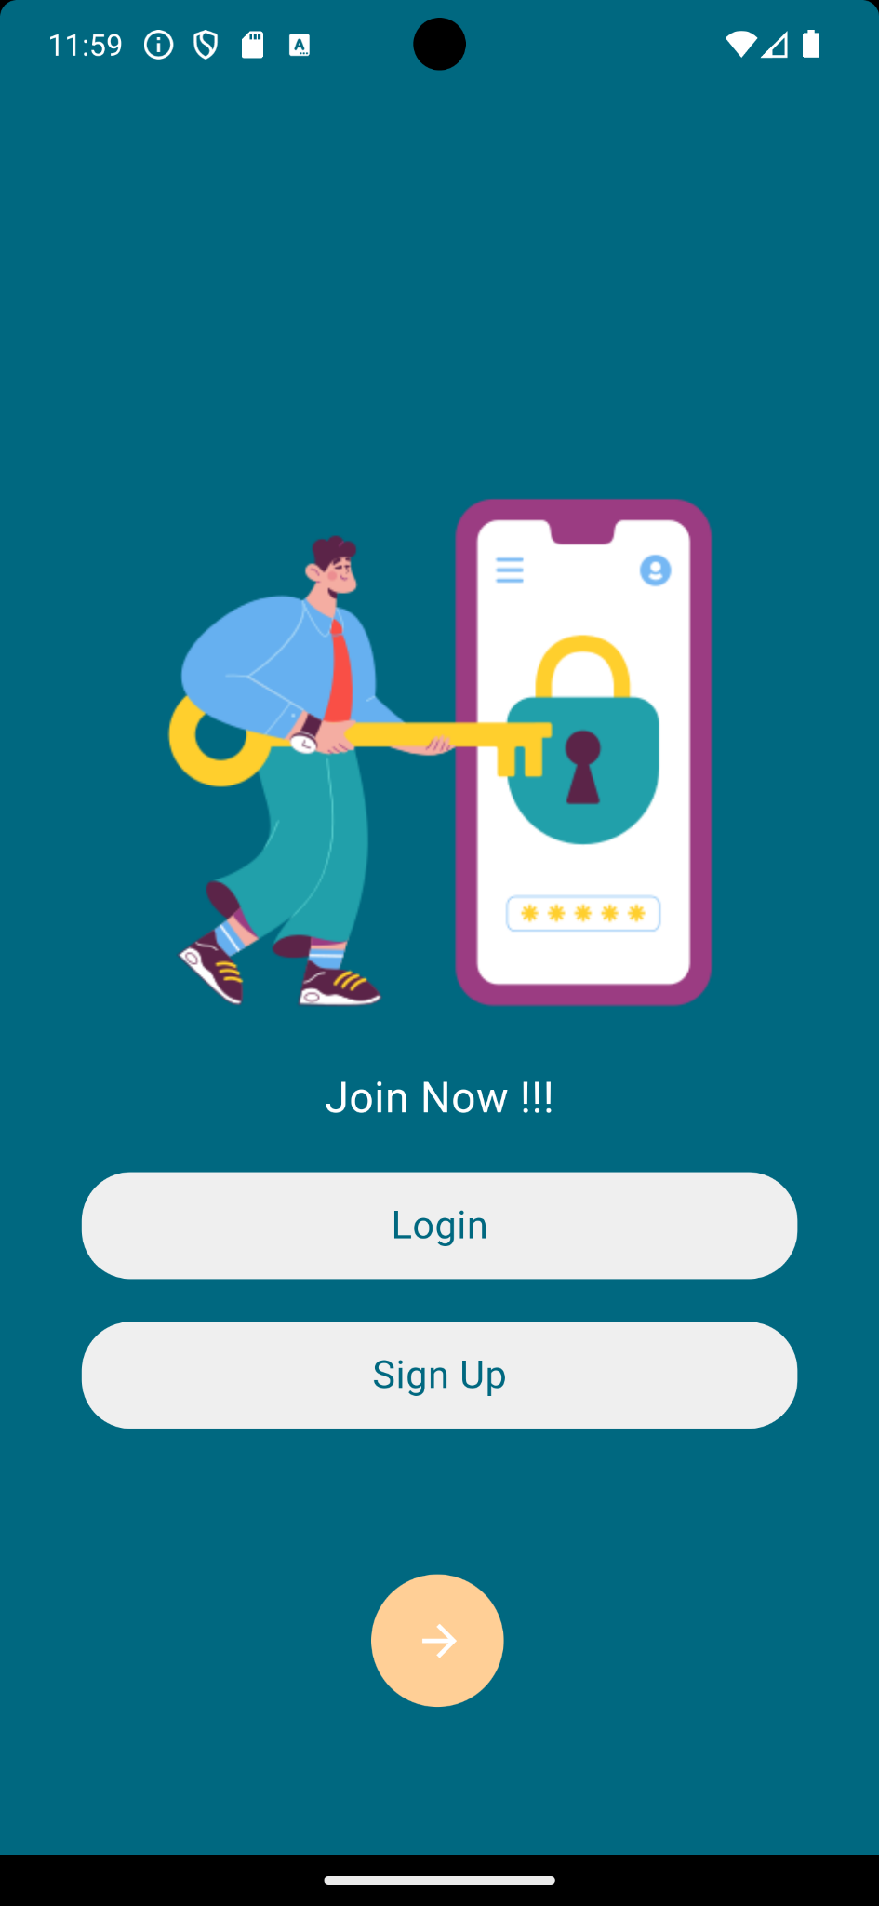

Slide 34
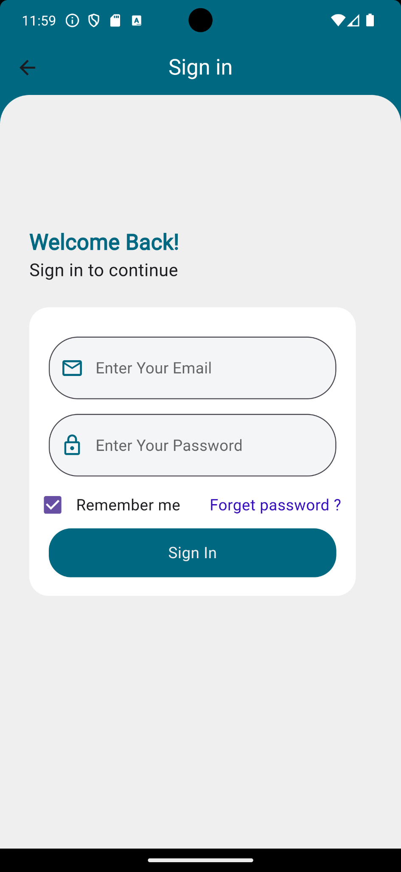
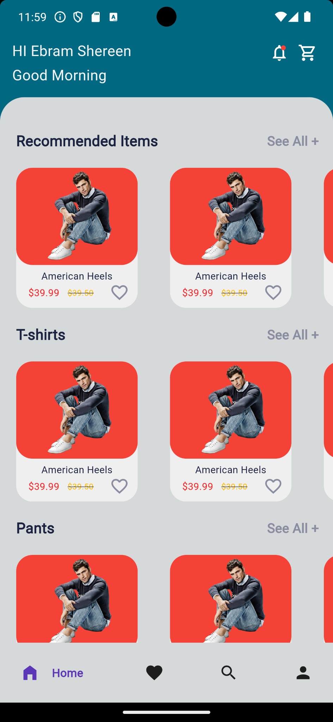
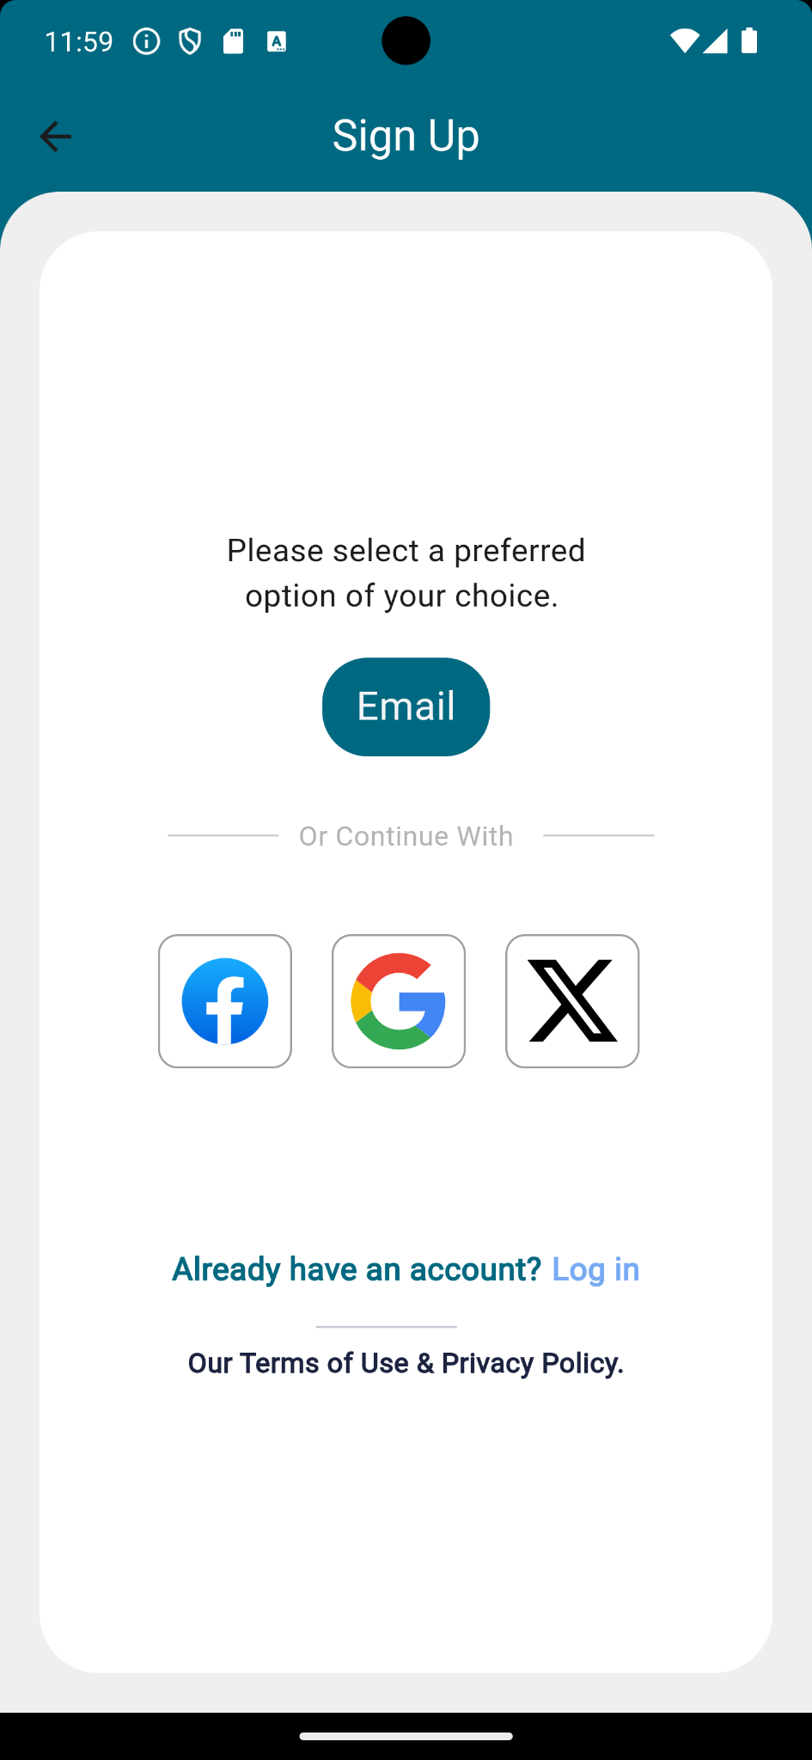
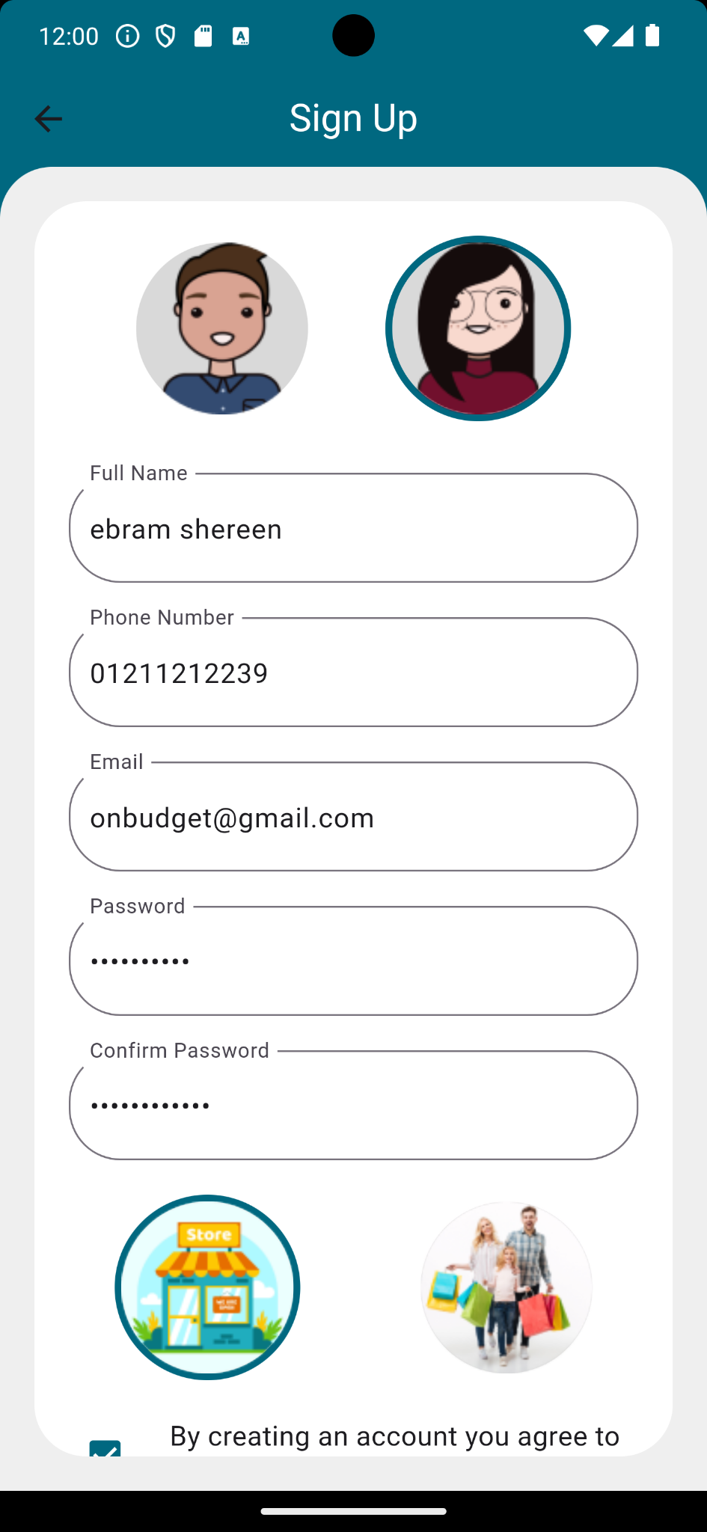

Slide 35
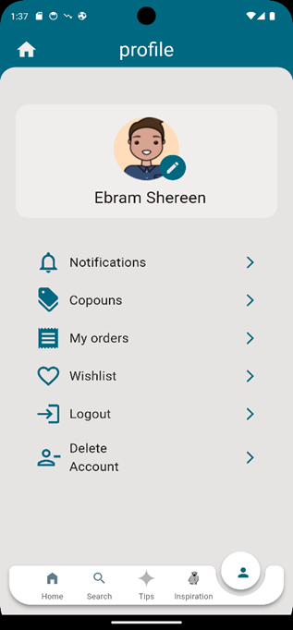

Slide 36
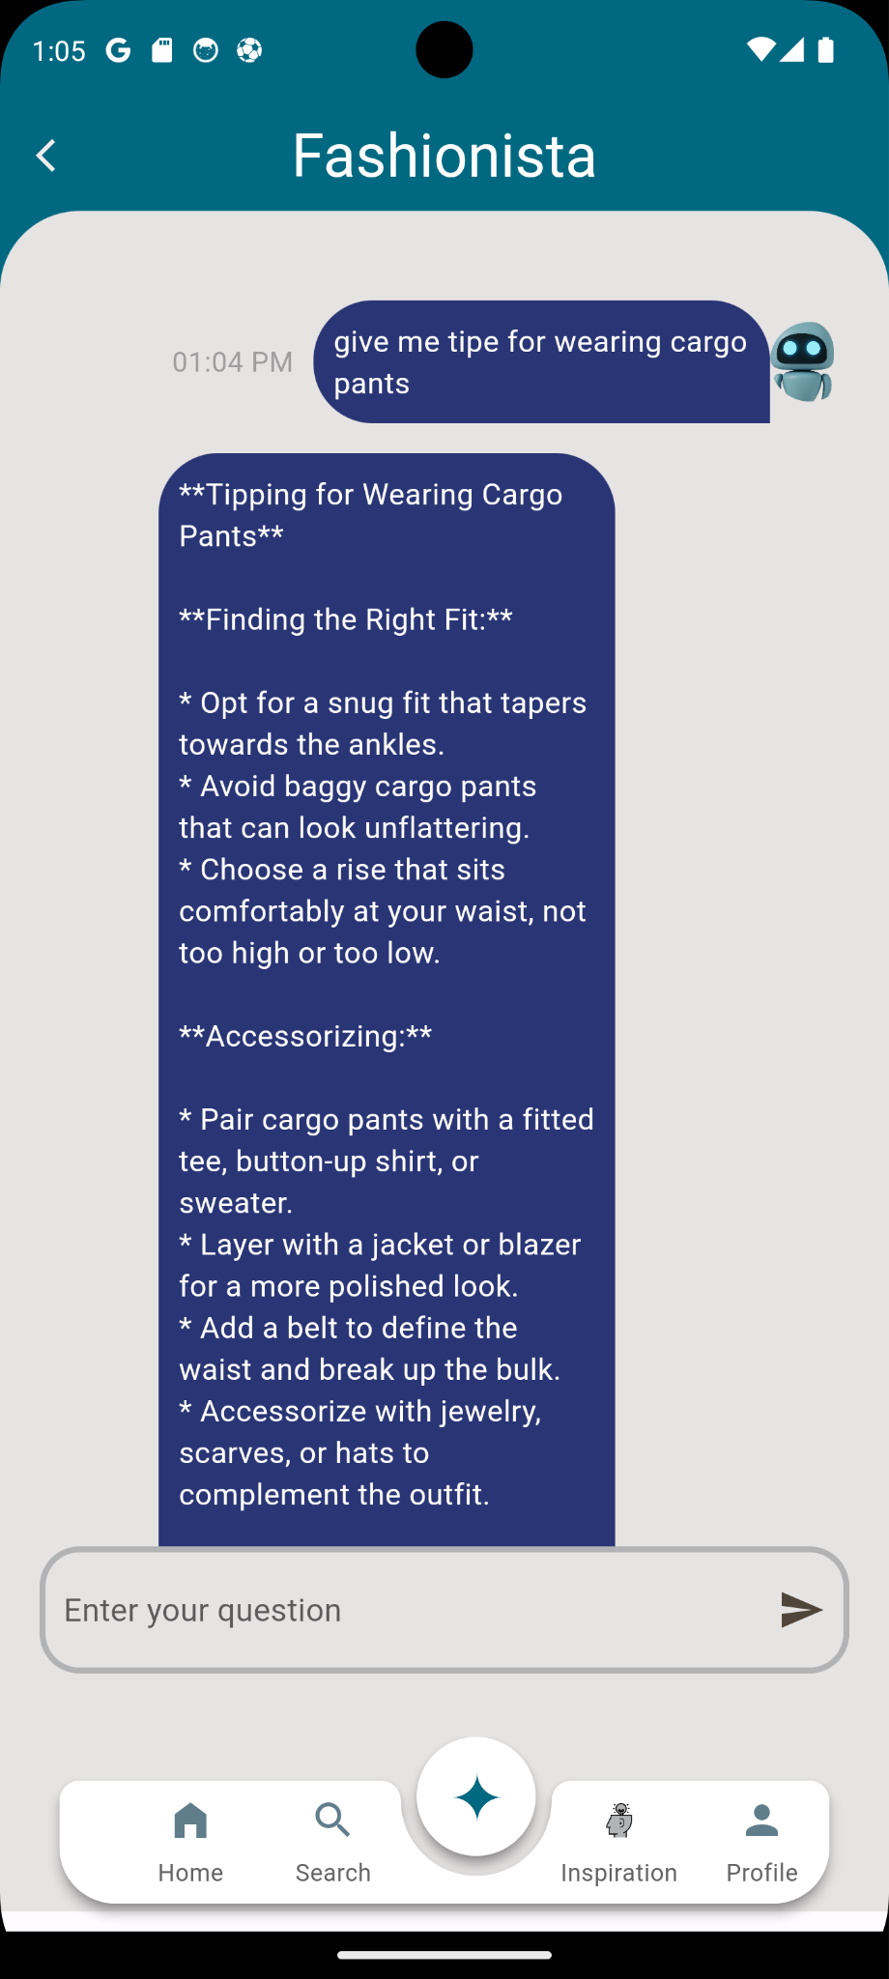
Gemini chatbot

Slide 37
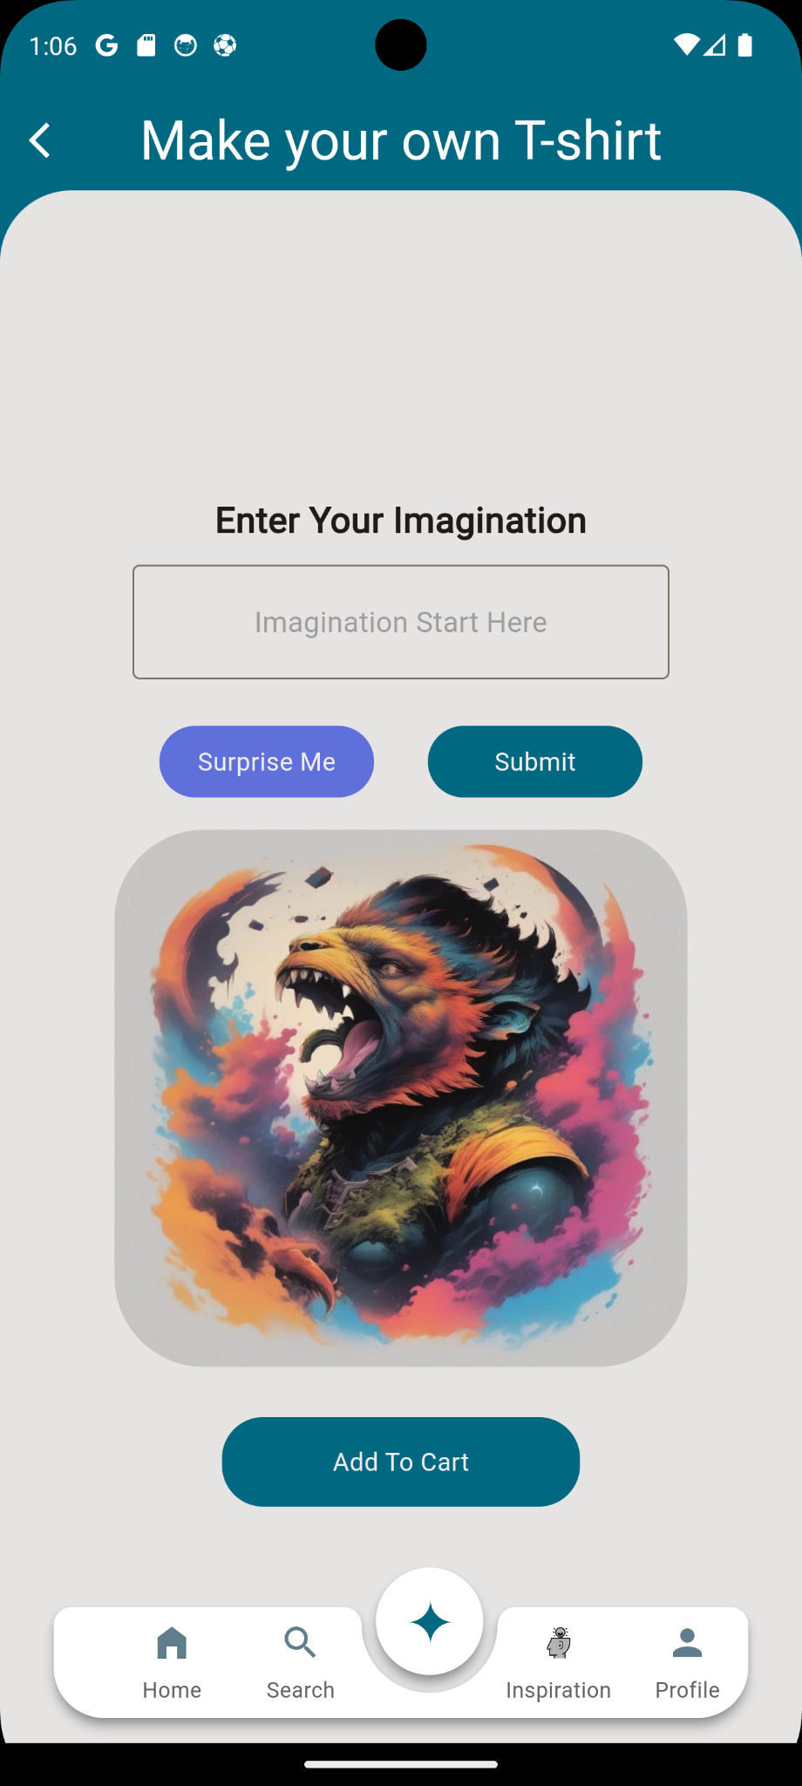
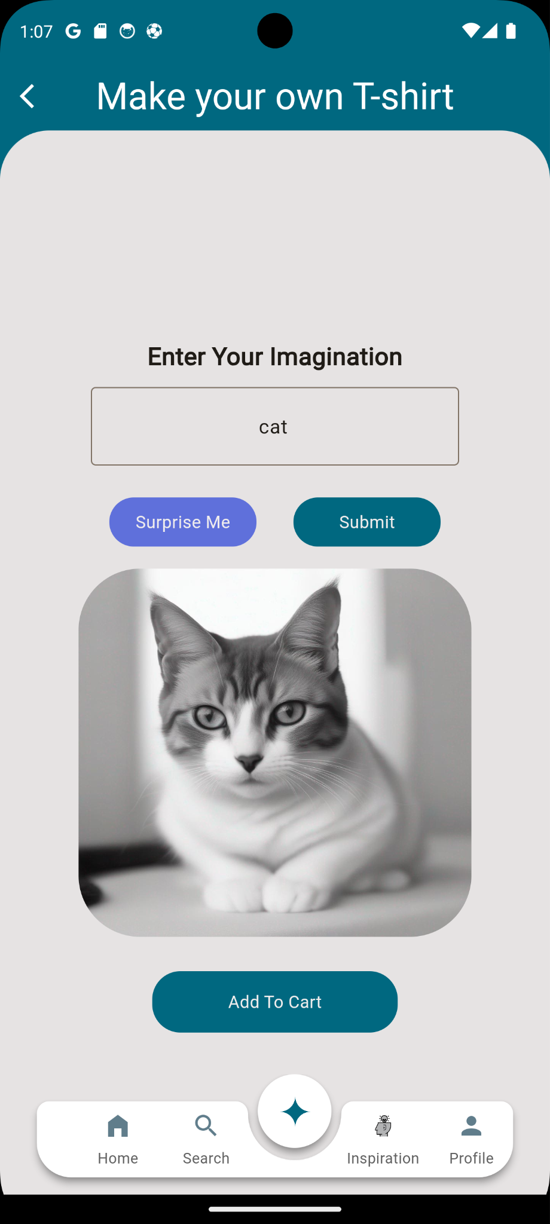
Custom your own t-shirt

Slide 38
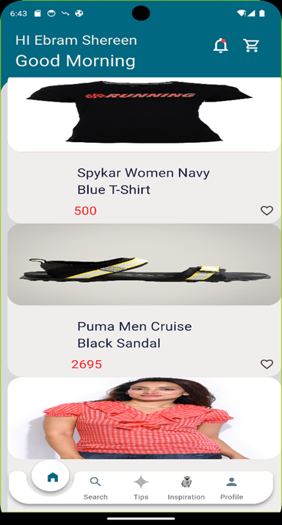

Slide 39
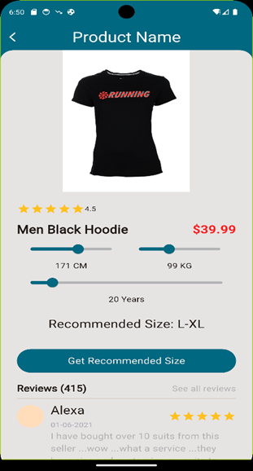

Slide 40
07
Website

Slide 41
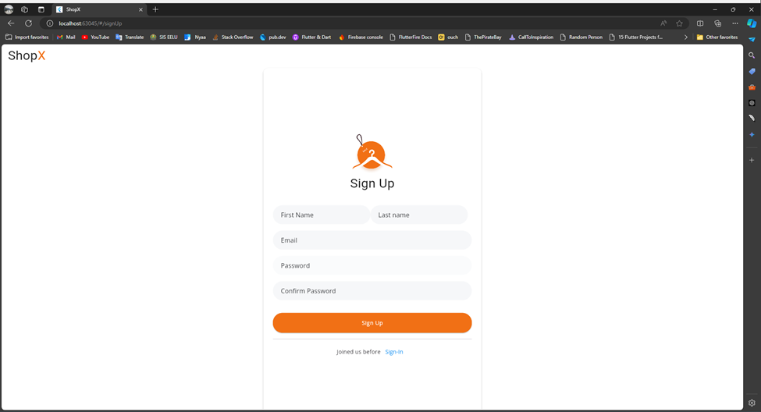

Slide 42
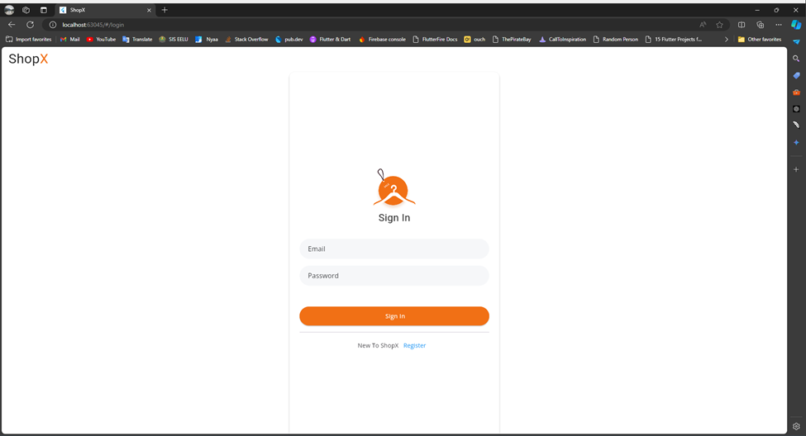

Slide 43
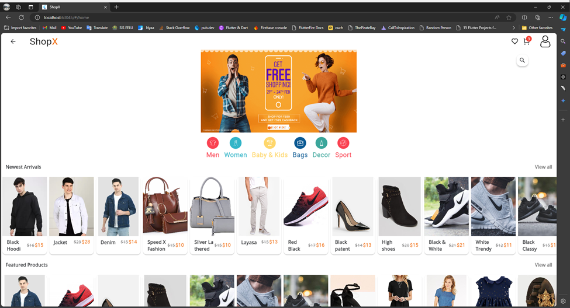

Slide 44
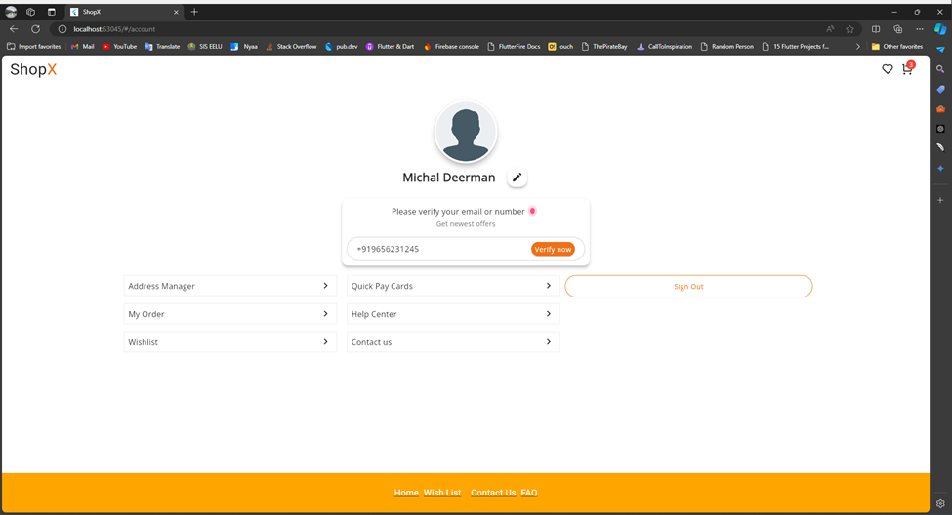

Slide 45
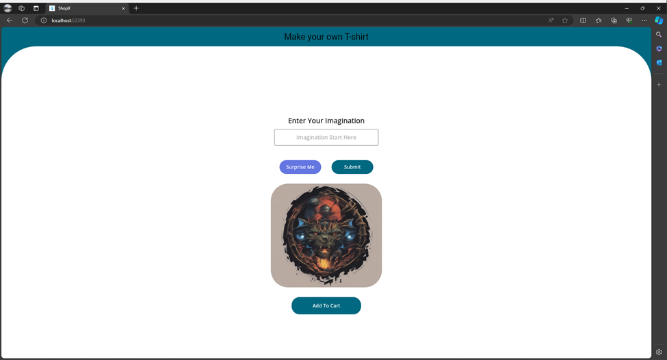

Slide 46
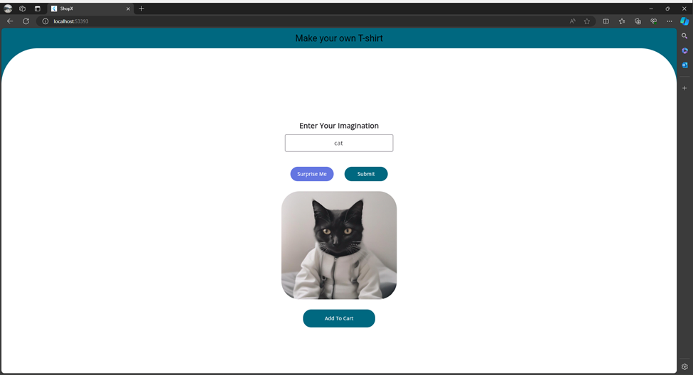

Slide 47
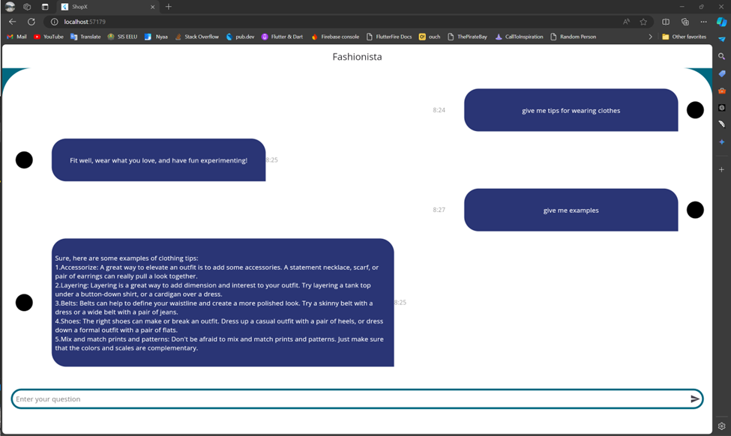

Slide 48

We’ve used SCSS instead of CSS because it provides more features, such as importing files and creating methods.
We’ve used SVG instead of PNG to control the image colors.
And I used GIF instead of PNG to add some animations.

Slide 49
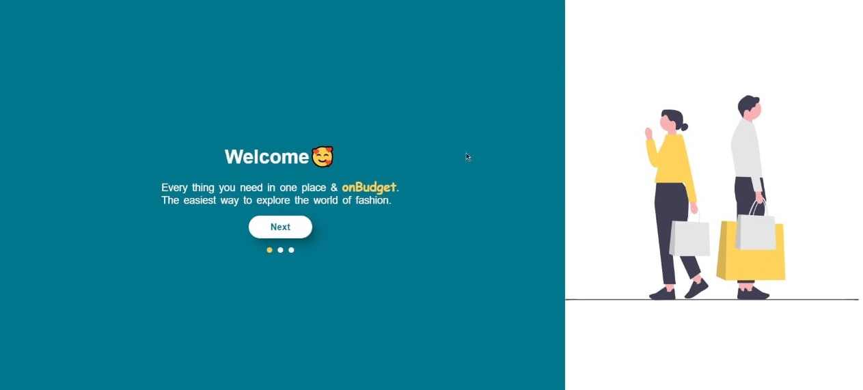
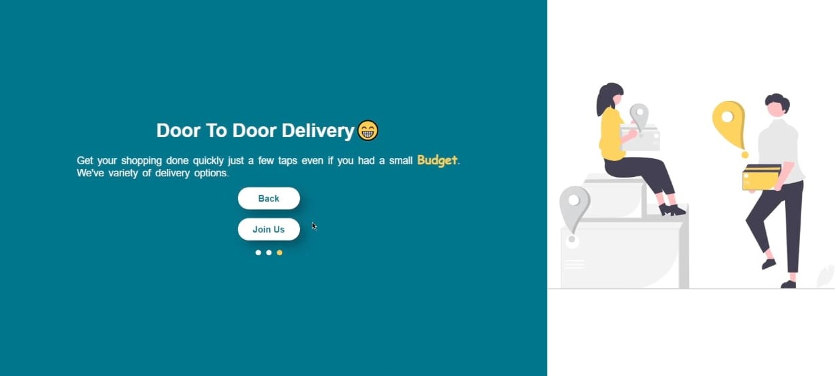
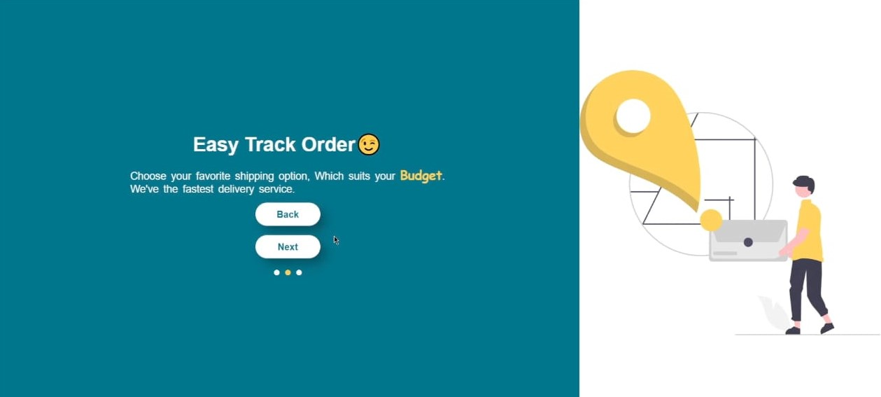


Slide 50



Slide 51



Slide 52



Slide 53
08
Back-End

Slide 54

Venus is the second planet from the Sun

Slide 55


Slide 56
ASP.NETCore
Code First
Migration
Function
API
DataBase
DataBase
Get
Restful API
Classes
Post
SQL Server
JSON File
Controller
Put
Delete

Slide 57
BackEnd
Code
Migration
Local
API
DA Layer
DataBase
Ngrok
Postman
BL Layer
P Layer

Slide 58
09
Gantt chart

Slide 59

Gantt chart
For more details :
https://sharing.clickup.com/36183846/tl/h/4-90080537882-16/174cf1995a5d5e1

Slide 60

Thanks
Any Questions
e for 2023
New employees next year

Slide 61
Talk back
…
5ls .. k code da bl p
W then mig => db check em all tables are rightly connected
Drop .. local=>est engrok 4 trans ghaz from loc 2 ser w can use data
Then out APIs 4 all func that we need in whole proj From controller => PL
And we handled it by postman

